Slide 1
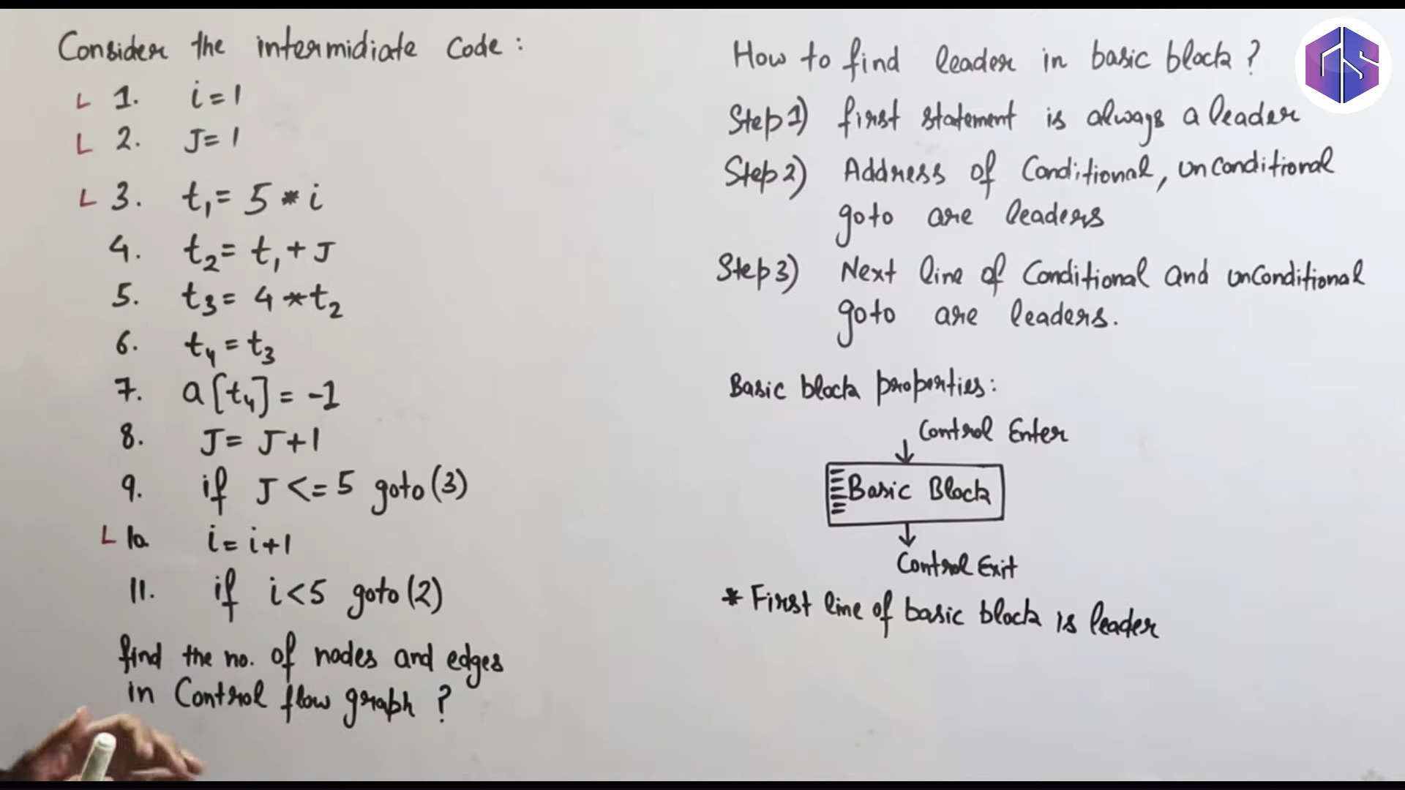
Lec-28: What is Control Flow Graph | Basic Blocks

Slide 3
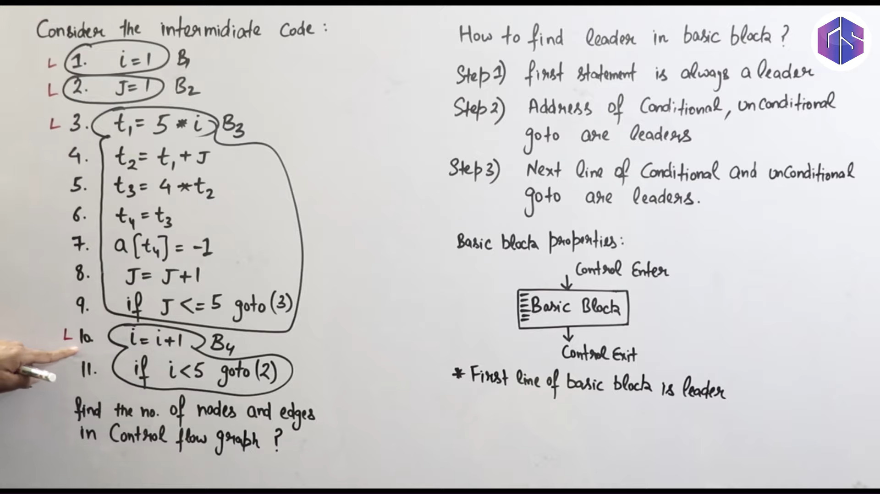

Slide 4
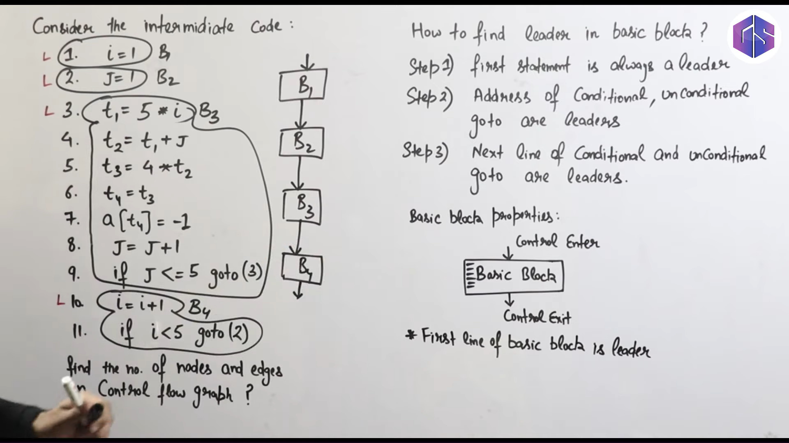

Slide 5
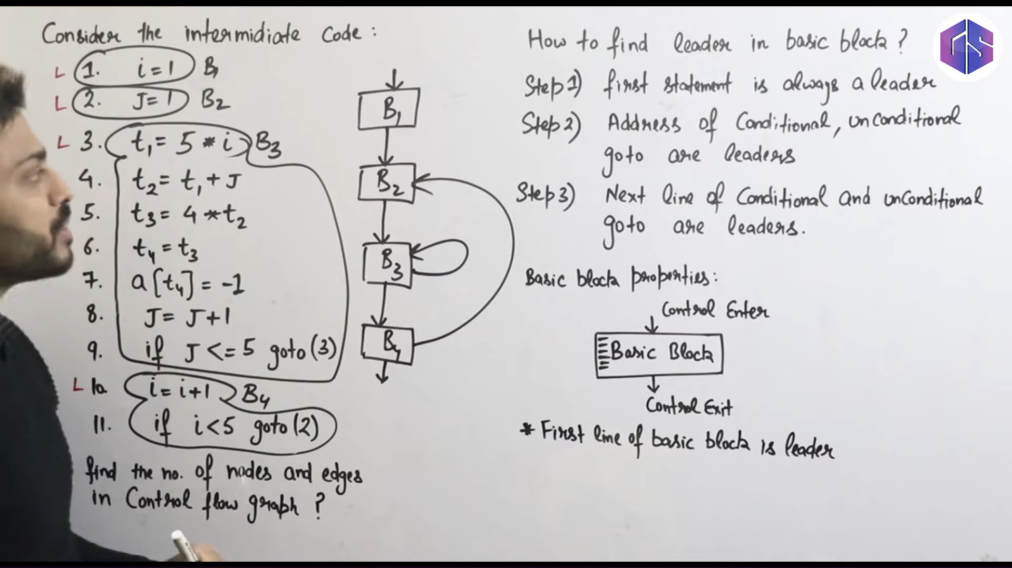

Slide 6
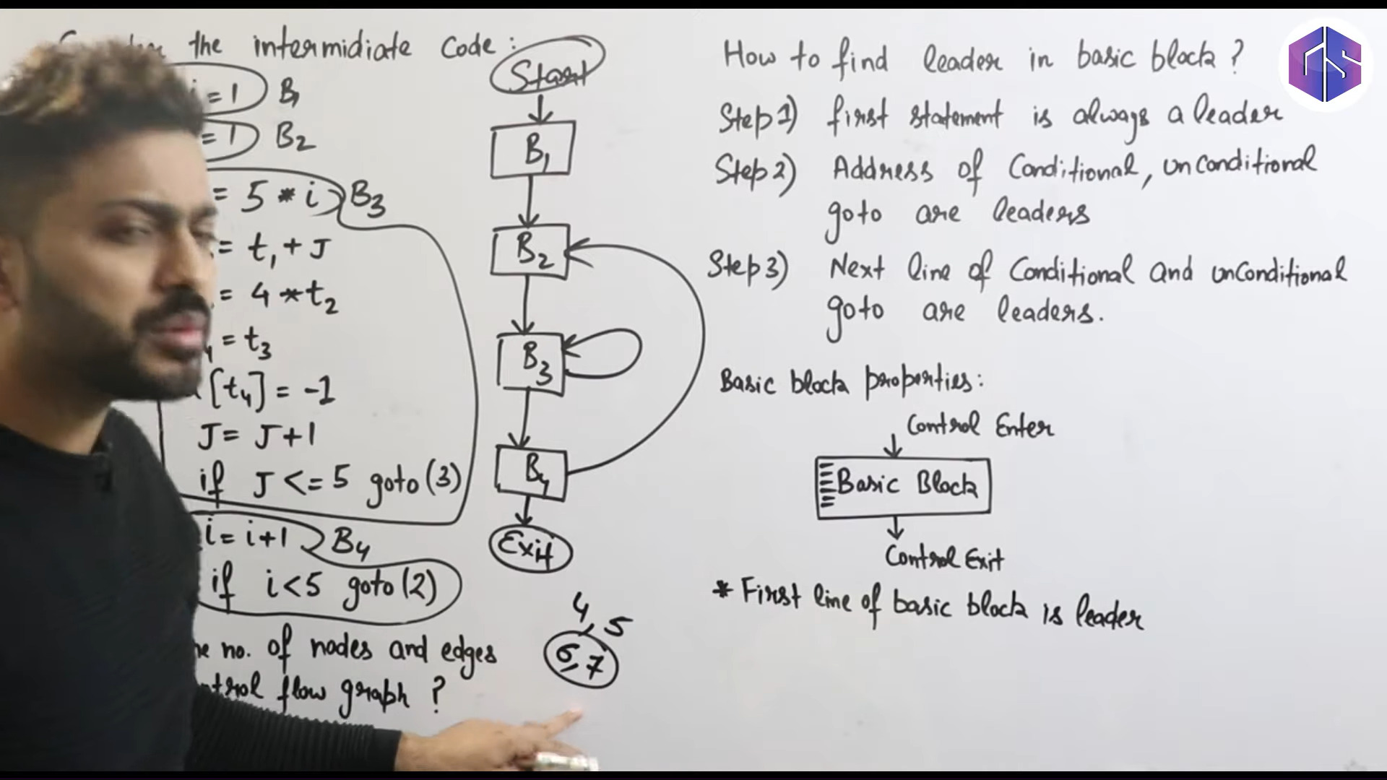

Slide 8
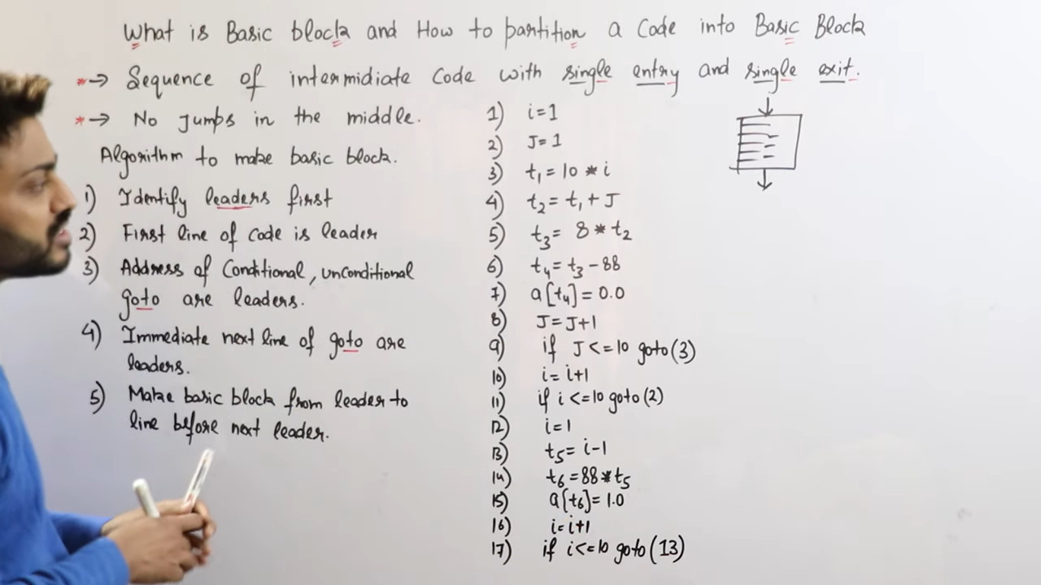
Lec-29: What is Basic Block & Flow Graph in Compiler | Partition Algorithm in Basic Bloc

Slide 9
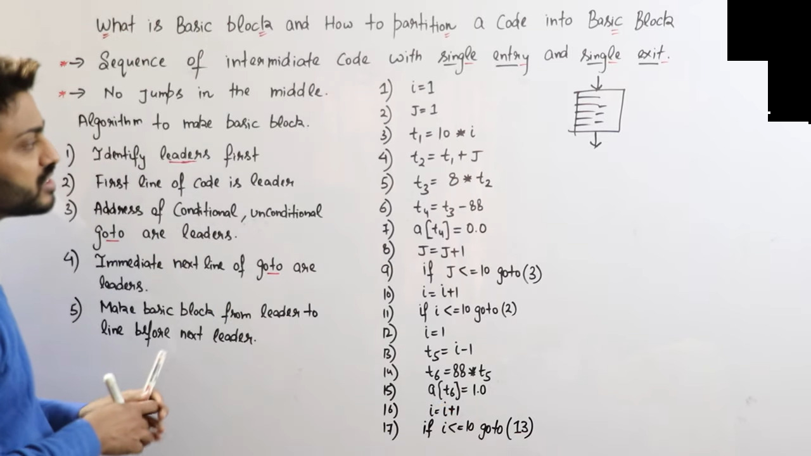

Slide 10
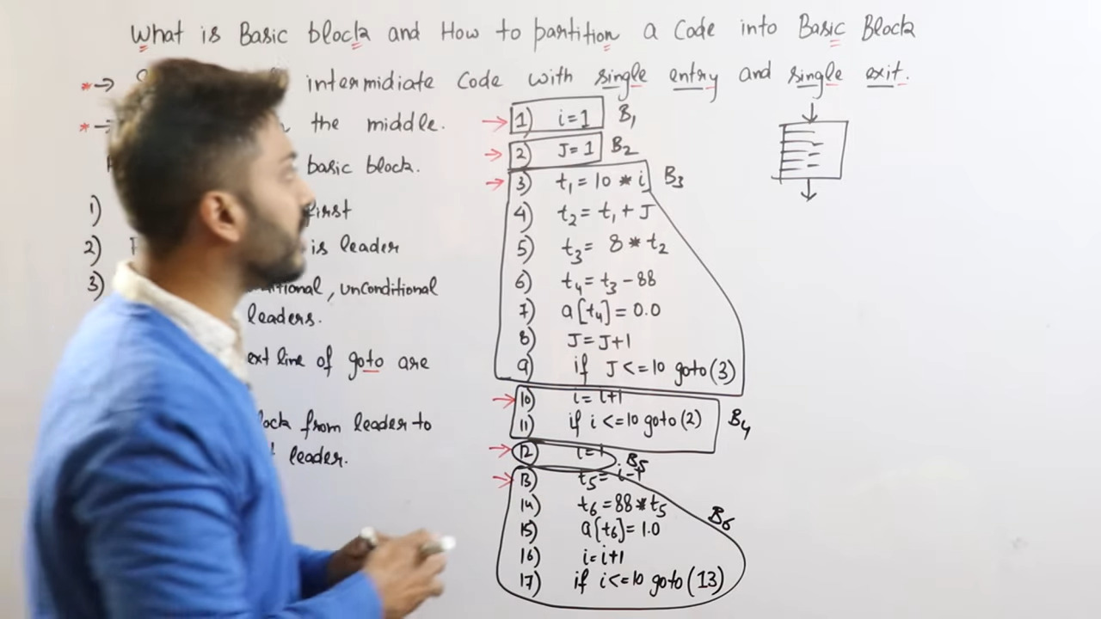

Slide 11
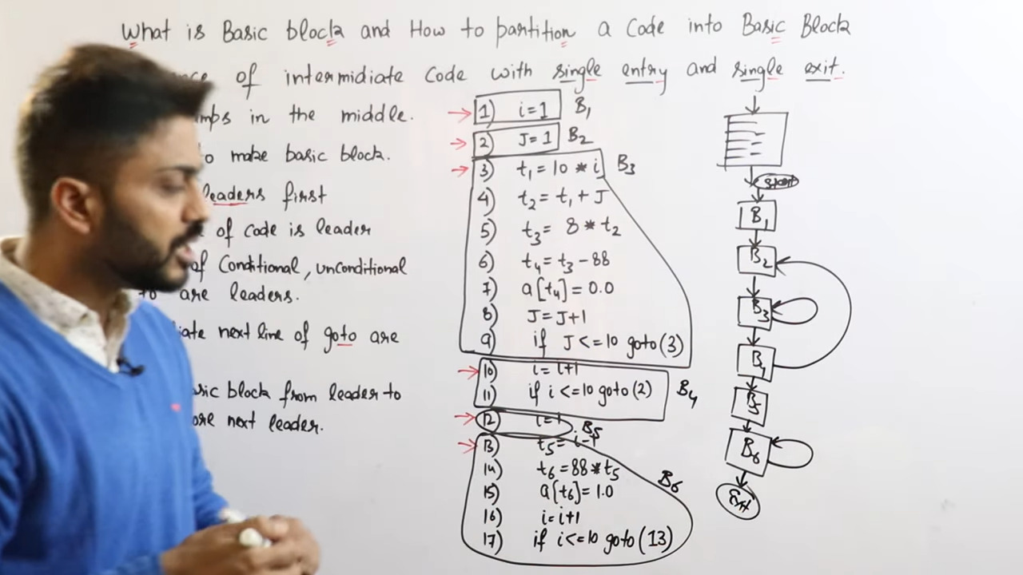

Slide 13
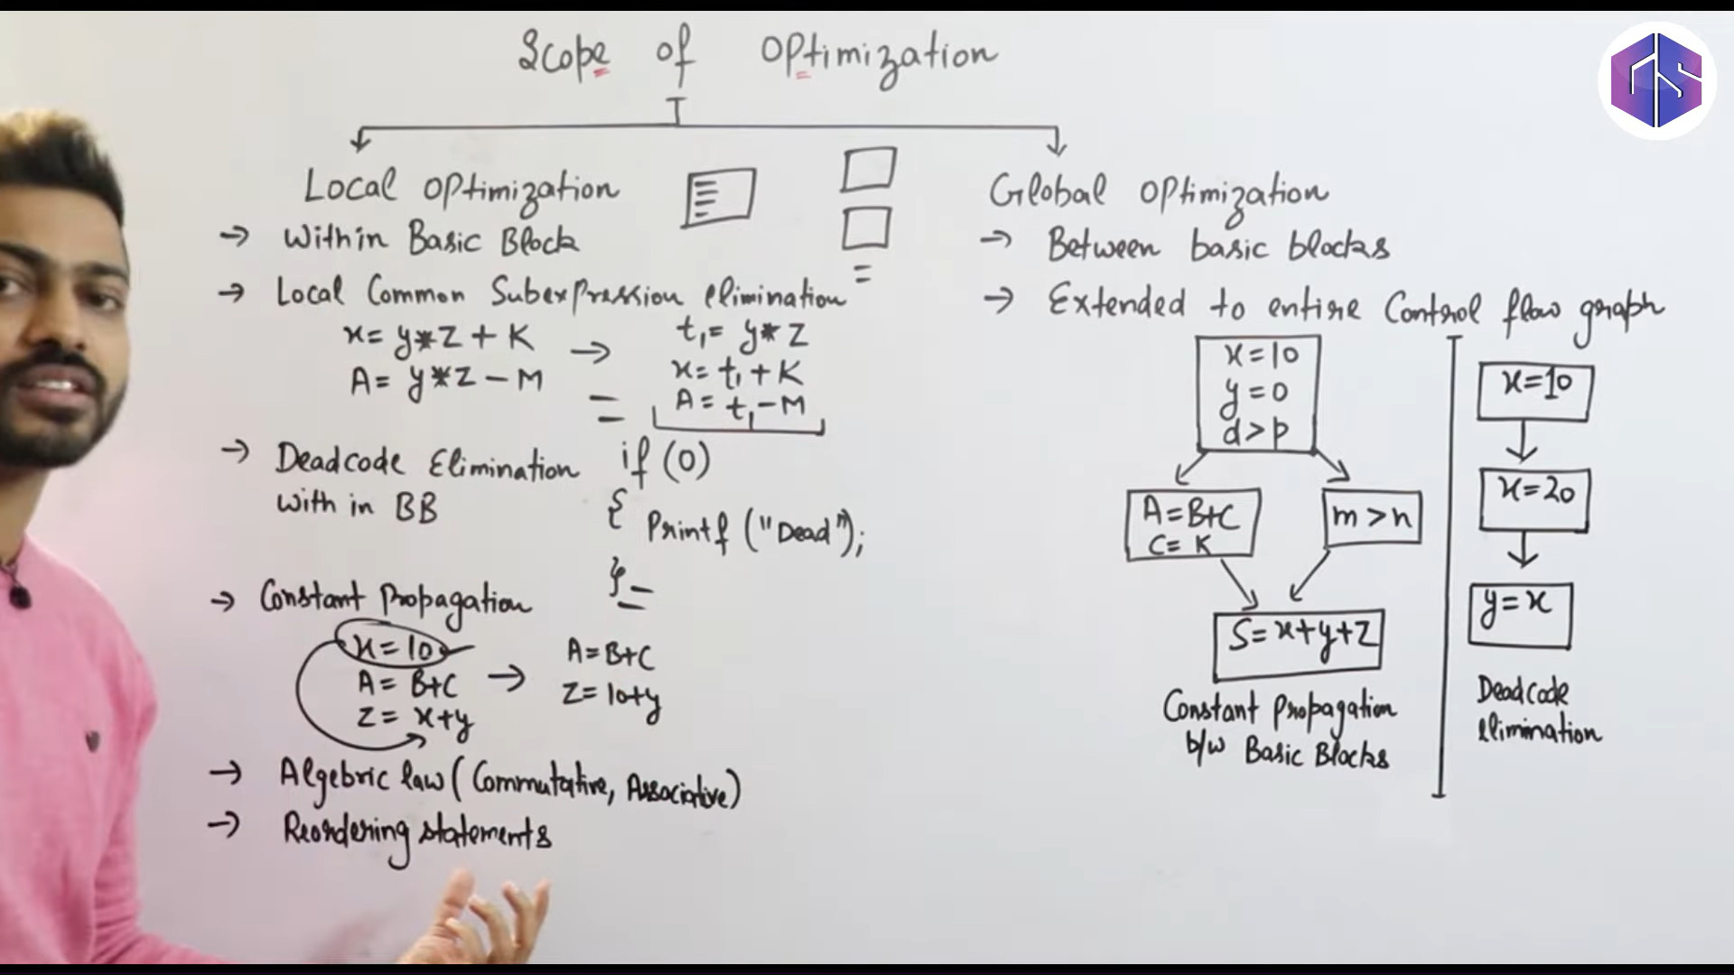
Lec-30: Local vs Global Optimization | Scope of Optimization

Slide 14
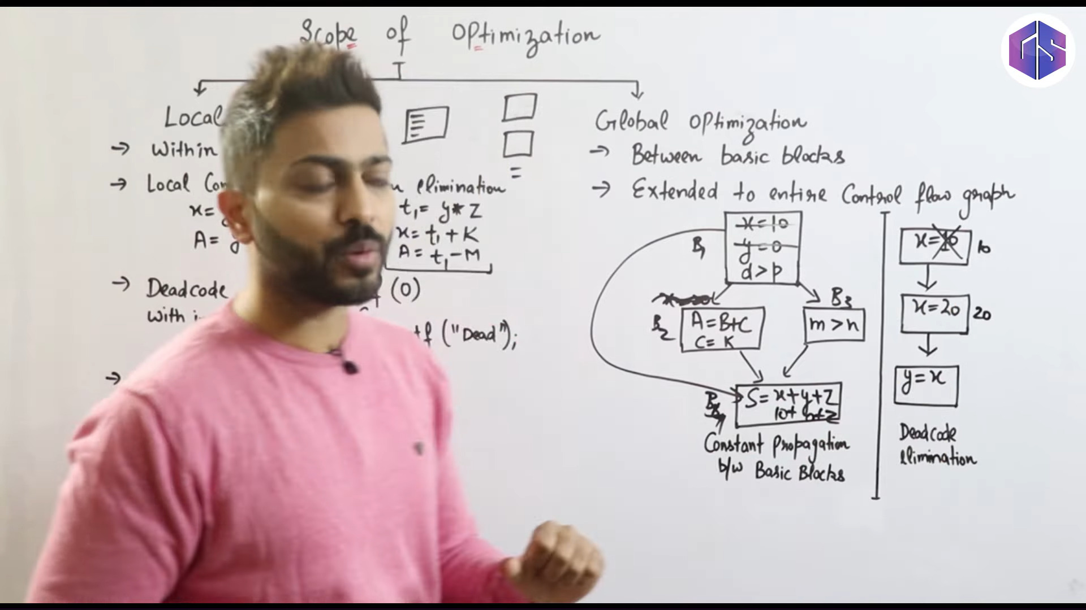

Slide 16
Optimizations
Lecture 21
Section 8.5, 9.1
Rokan Uddin Faruqui
Associate Professor
Dept of Computer Science and Engineering University of Chittaong, Bangladesh Email: rokan@cu.ac.bd

Slide 17
Source Program
Phases of compilation
Scanner (Lexical analysis)
Token Parser (Syntax analysis
Symbol Table
Frontend
Tree Semantic analysis
Tree Intermediate code generation
IR
Machine-independent code optimization
IR
Target code generation
Backend
Target Code
Machine-specific code improvement (optional)
Target Code
Optimizations

Slide 19
Optimizations
Phases of compilation
local optimizations – within a basic block,
global optimizations – between basic blocks.
Optimizations

Slide 20


Local Optimization
Outline
1 Local Optimization
2 Global Optimization
Optimizations

Slide 21
DAG for basic blocks
Local Optimization
Three-address code to DAG structure: One leaf per initial value.
One node per statement, with an edge to the node representing the operand value(s).
Inner node is labelled by operator, and list of variables, which computes the value.
Output nodes are those labelled with live exit variables.
Optimizations

Slide 22
DAG for basic blocks
Local Optimization
Three-address code to DAG structure: One leaf per initial value.
One node per statement, with an edge to the node representing the operand value(s).
Inner node is labelled by operator, and list of variables, which computes the value.
Output nodes are those labelled with live exit variables.
Optimizations

Slide 23
DAG for basic blocks
Local Optimization
Three-address code to DAG structure: One leaf per initial value.
One node per statement, with an edge to the node representing the operand value(s).
Inner node is labelled by operator, and list of variables, which computes the value.
Output nodes are those labelled with live exit variables.
Optimizations

Slide 24
DAG for basic blocks
Local Optimization
Three-address code to DAG structure: One leaf per initial value.
One node per statement, with an edge to the node representing the operand value(s).
Inner node is labelled by operator, and list of variables, which computes the value.
Output nodes are those labelled with live exit variables.
Optimizations

Slide 25
DAG optimization uses
Local Optimization
Local common subexpressions. Dead code elimination.
Apply algebraic simplifications.
Reorder statements that do not depend on one other.
Optimizations

Slide 26
Local common subexpressions
Local Optimization
Eliminate instructions that has already been computed.
a = b + c
b = a − d
c = b + c
d = a − d
Optimizations

Slide 27
Local common subexpressions
Local Optimization
Eliminate instructions that has already been computed.
a = b + c
b = a − d
c = b + c
d = a − d
Optimizations

Slide 28
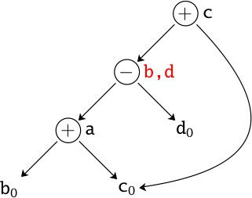
Local common subexpressions
Local Optimization
Eliminate instructions that has already been computed.
a = b + c
b = a − d
c = b + c
d = a − d
Optimizations

Slide 29
Local common subexpressions
Local Optimization
Eliminate instructions that has already been computed.
a = b + c
b = a − d
c = b + c
d = a − d
Optimizations

Slide 30
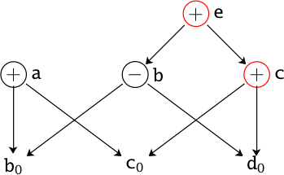
Dead code elimination
Local Optimization
Eliminate instructions that compute values that are never used
a = b + c
b = b − d
c = c + d e = b + c
Optimizations

Slide 31
Dead code elimination
Local Optimization
Eliminate instructions that compute values that are never used
a = b + c (dead code)
b = b − d
c = c + d e = b + c
Optimizations

Slide 32

Algebraic Identities
Local Optimization
Apply algebraic simplification rules.
x + 0 = 0 + x = x
x − 0 = x
x × 1 = 1 × x = x
x/1 = x
2 + 2 = 4(constant folding)
ExpensiveCheaper
x² = x × x(lib function)
2 × x = x + x x/2 = x × 0.5
Optimizations

Slide 33
Algebraic Identities
Local Optimization
Commutativity with local common subexpressions.
Associativity with composite expressions....
+ e
a = c + b e = c + d + b
₊ ¸) _{a}
,˛_{d0}
)¸ ,˛_{c0}
b₀
Optimizations

Slide 34
Algebraic Identities
Local Optimization
Commutativity with local common subexpressions.
Associativity with composite expressions....
+ e
a = c + b e = c + d + b
₊ ¸) _{a}
,˛_{d0}
)¸ ,˛_{c0}
b₀
Optimizations

Slide 35
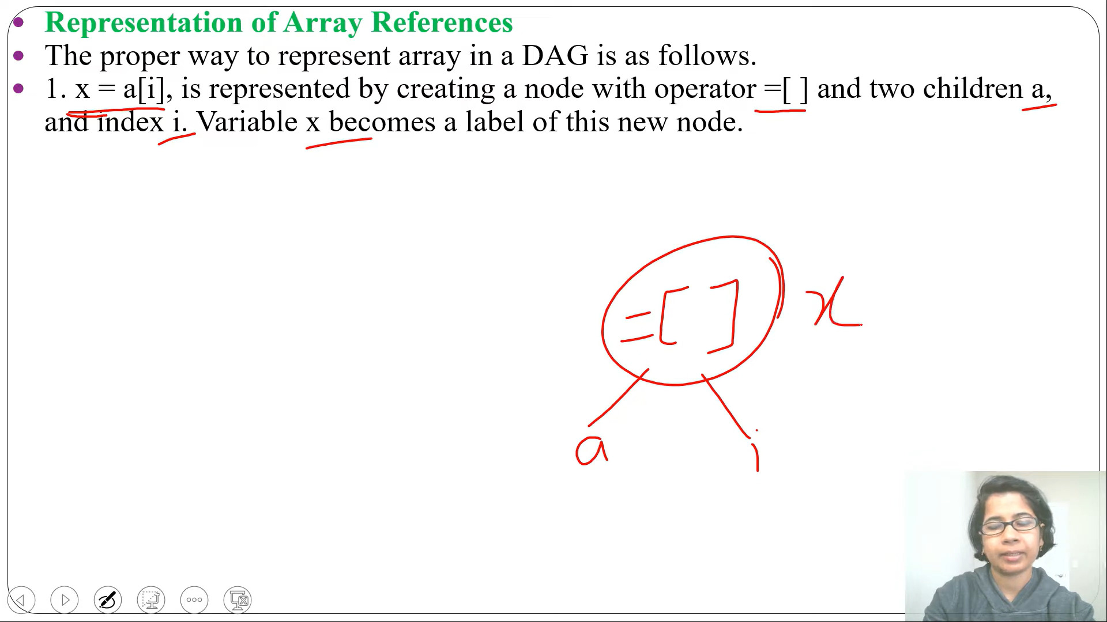

Slide 36
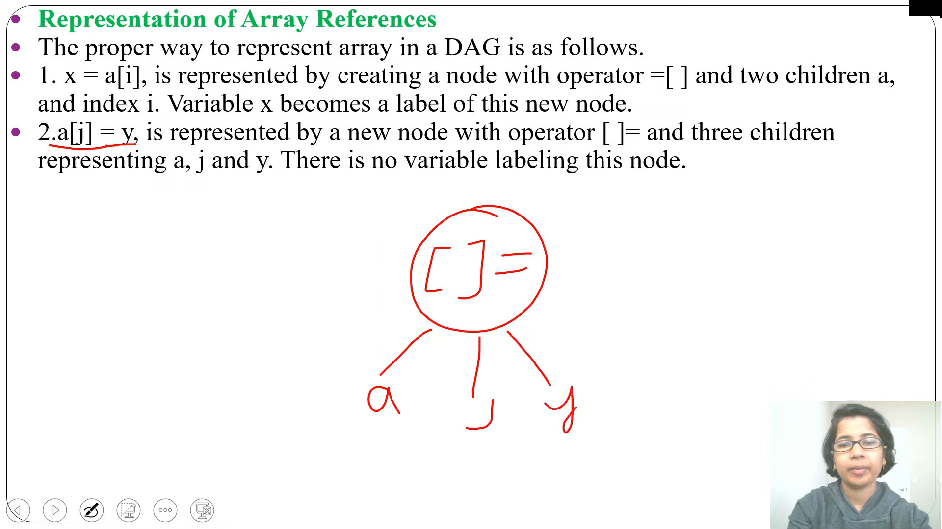

Slide 37
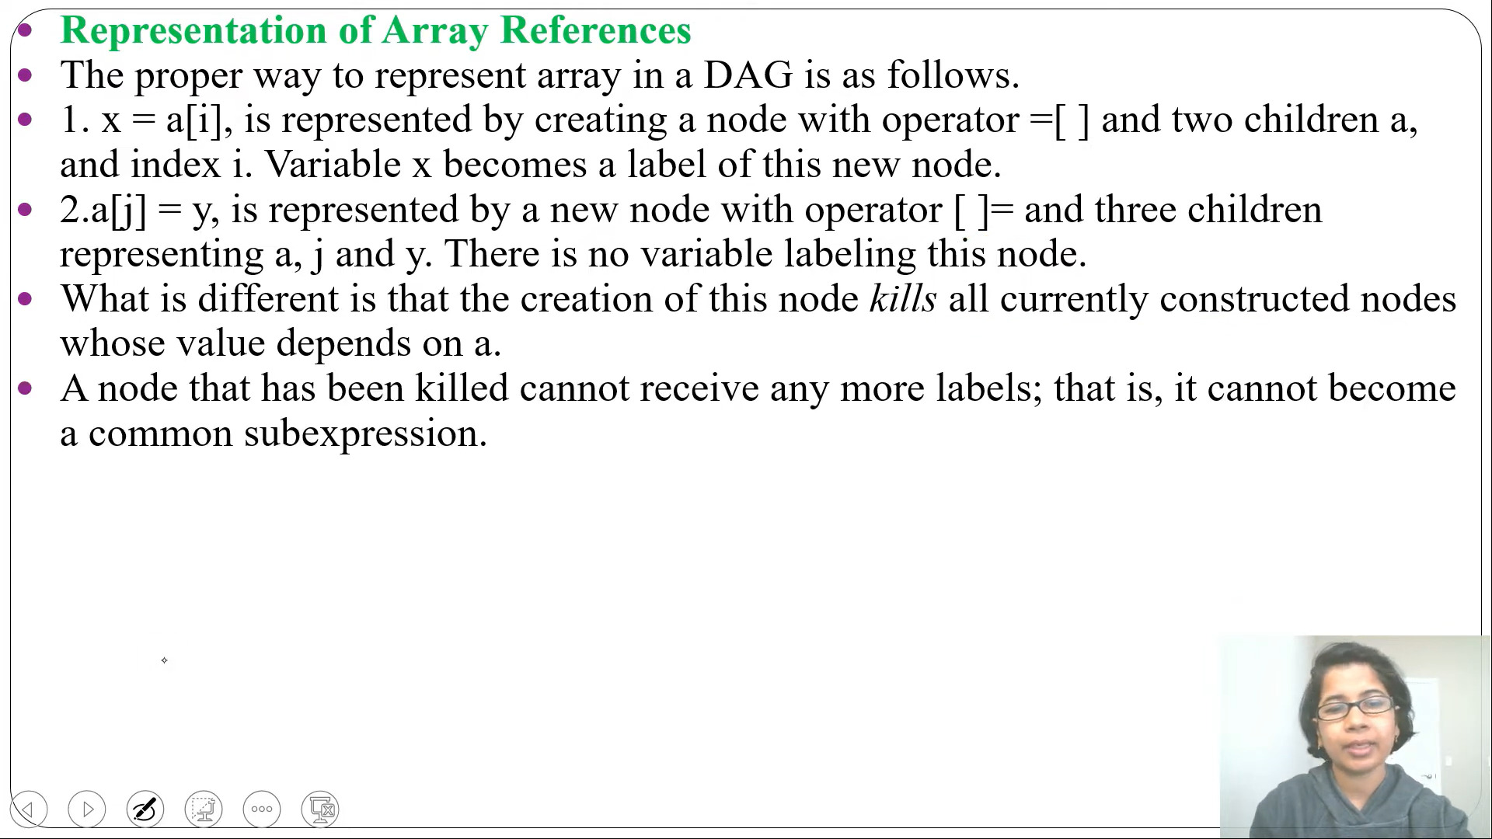

Slide 38
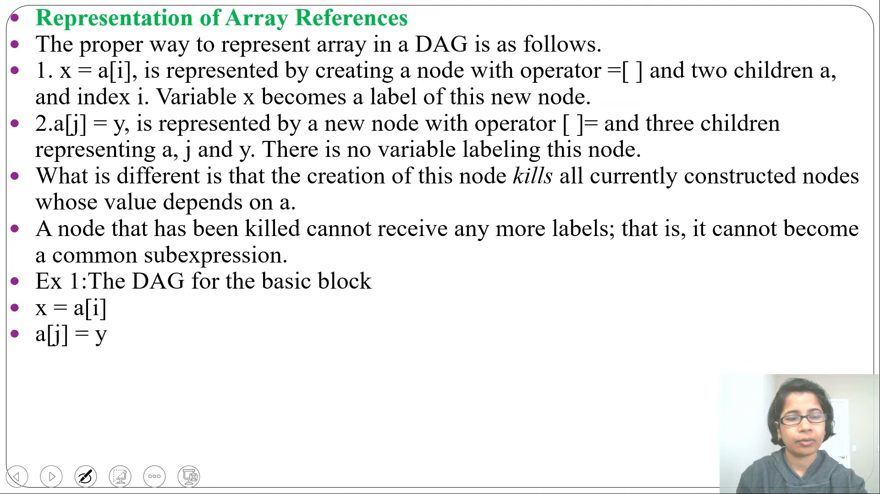

Slide 39
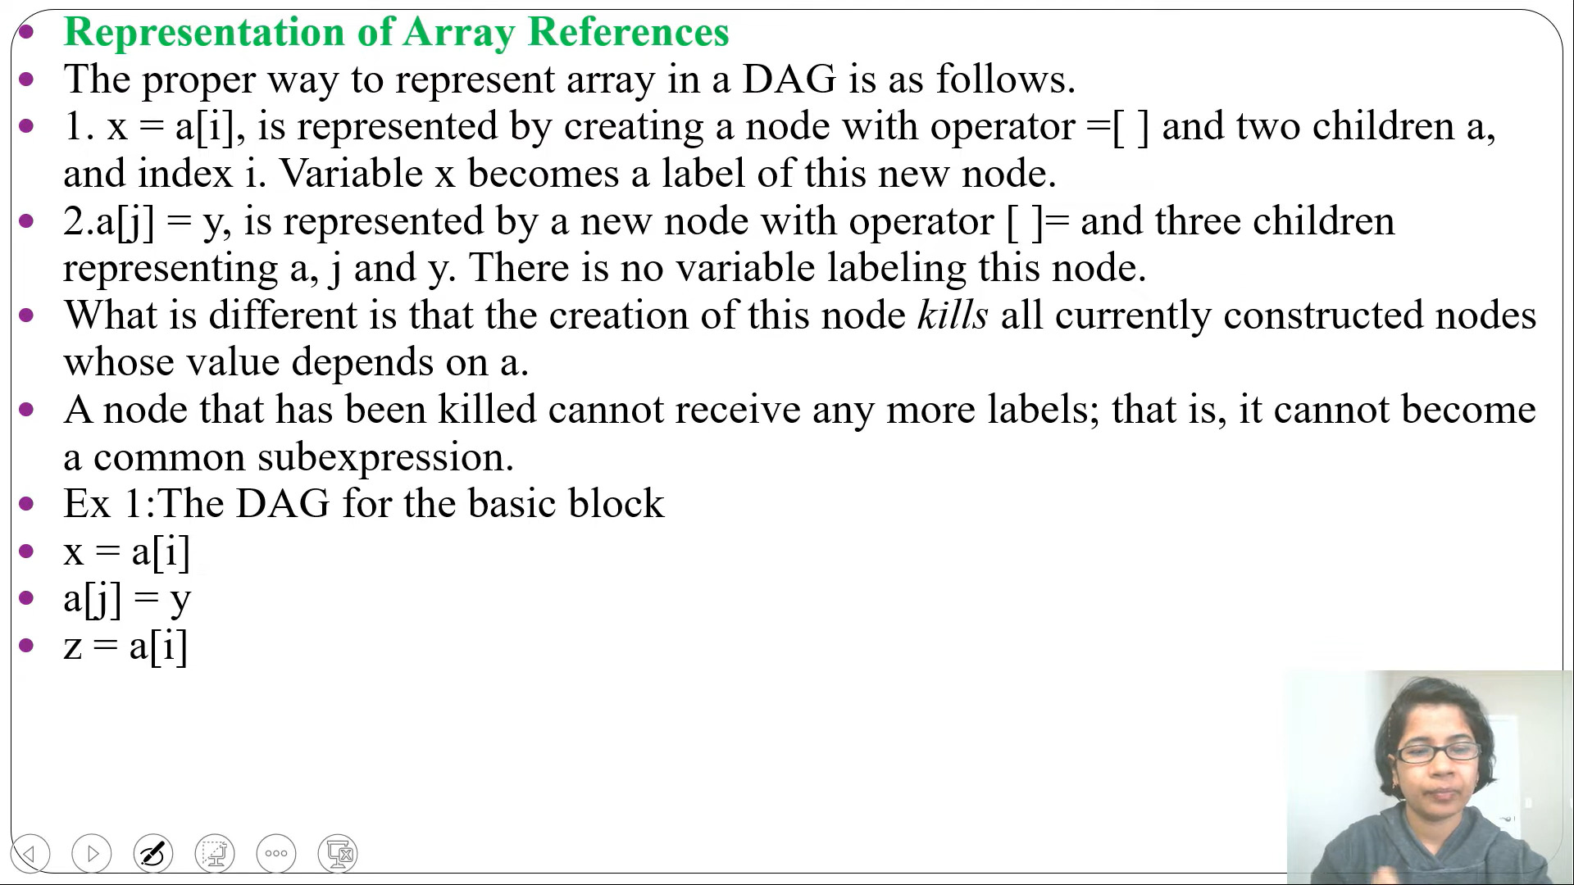

Slide 40
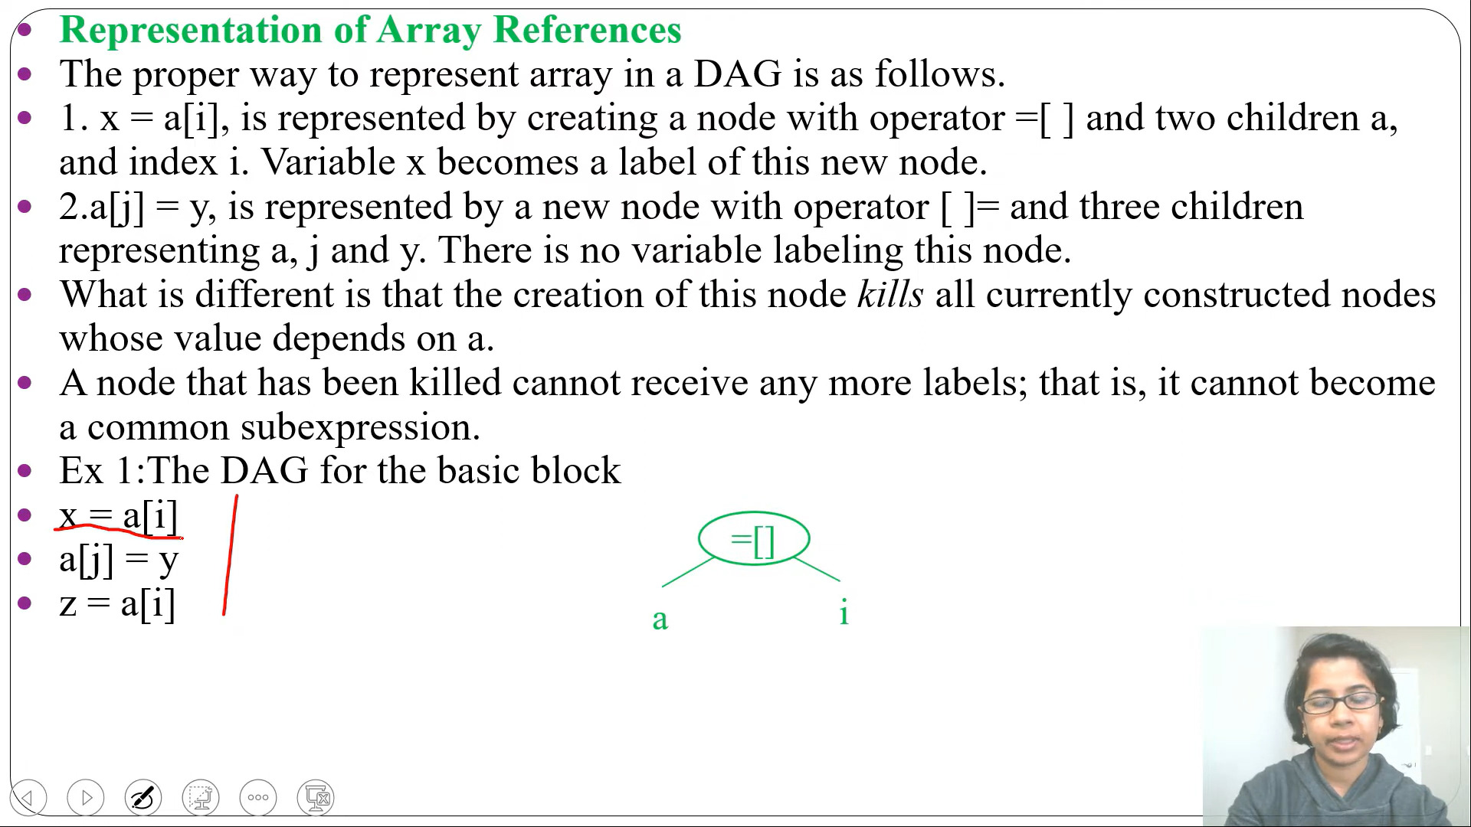

Slide 41
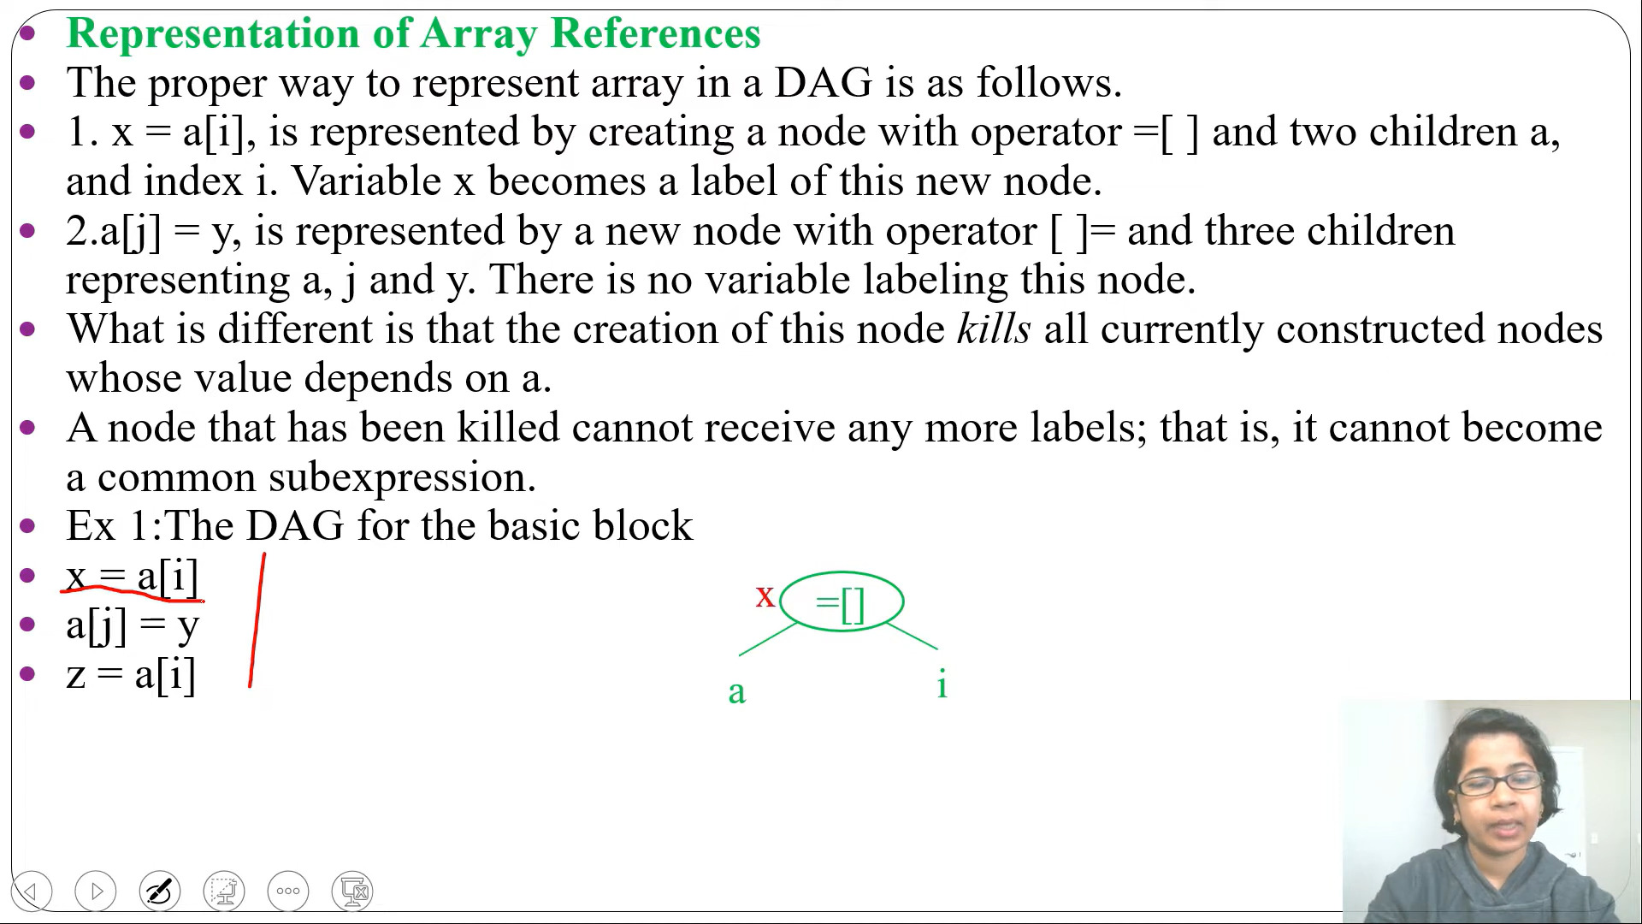

Slide 42
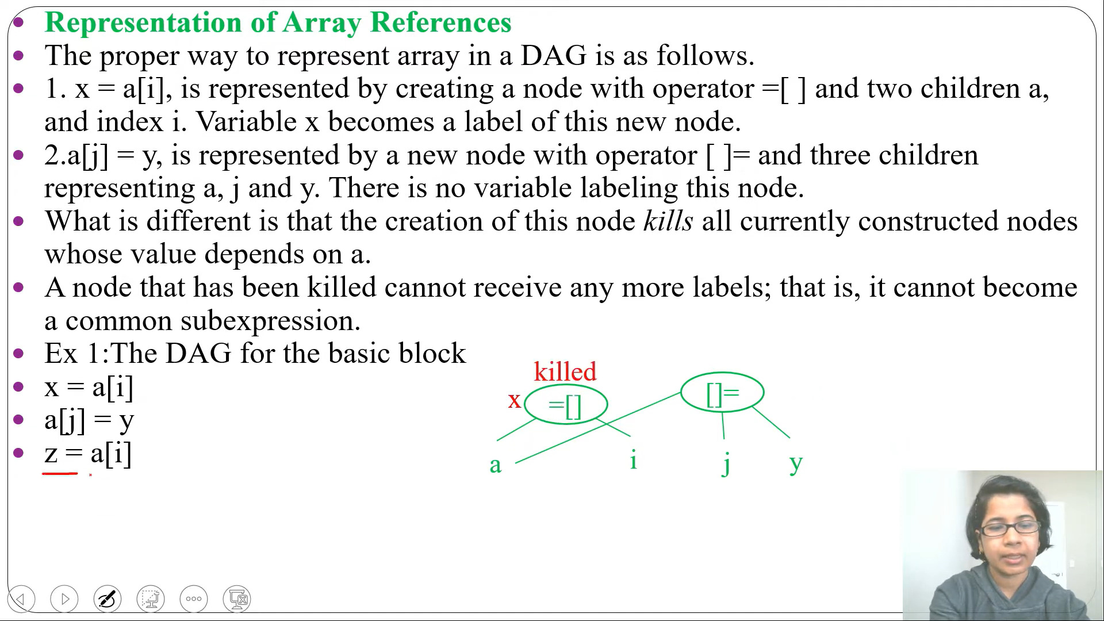

Slide 43
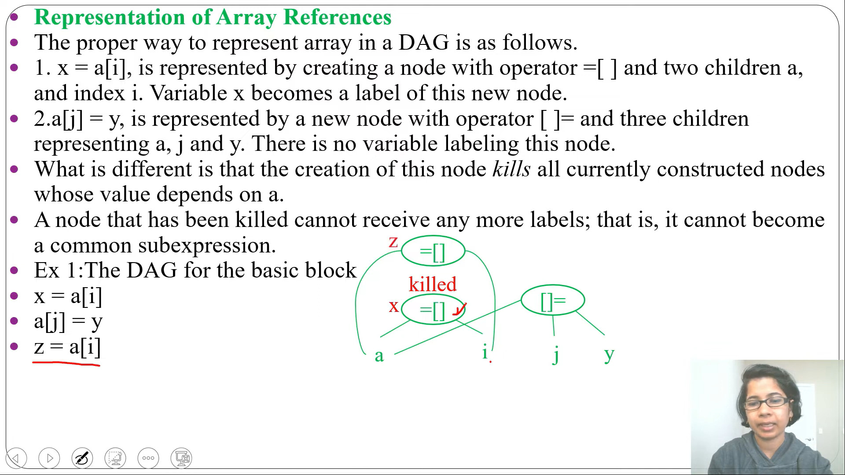

Slide 44
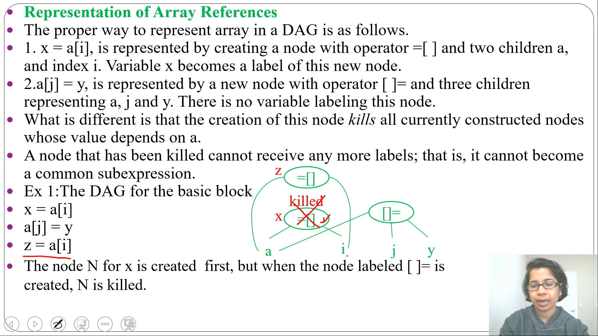

Slide 45
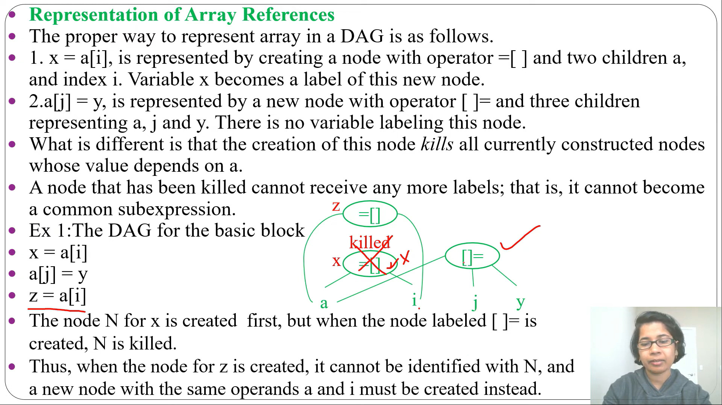

Slide 46
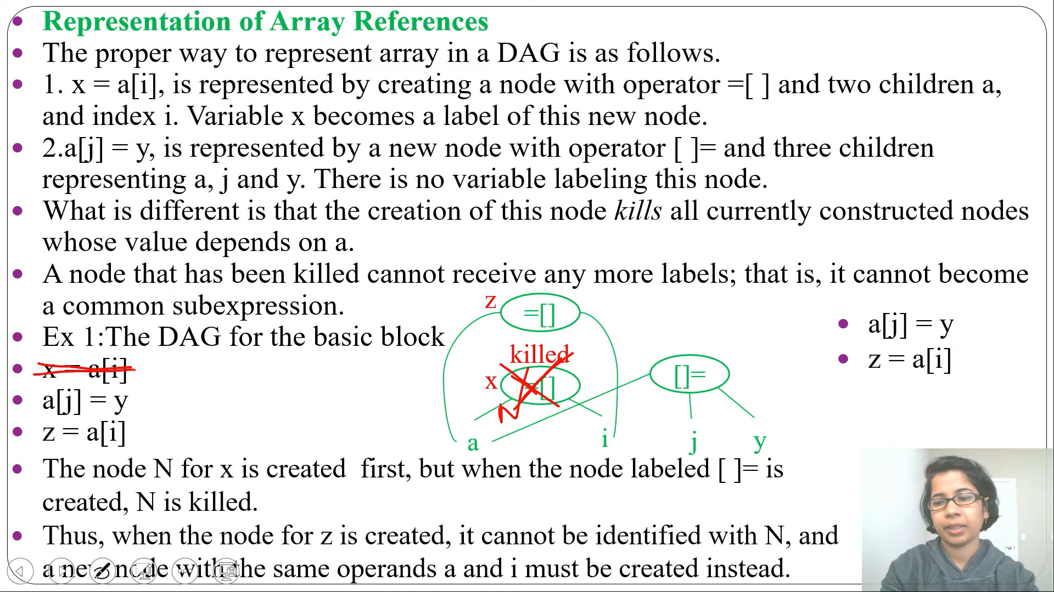

Slide 47
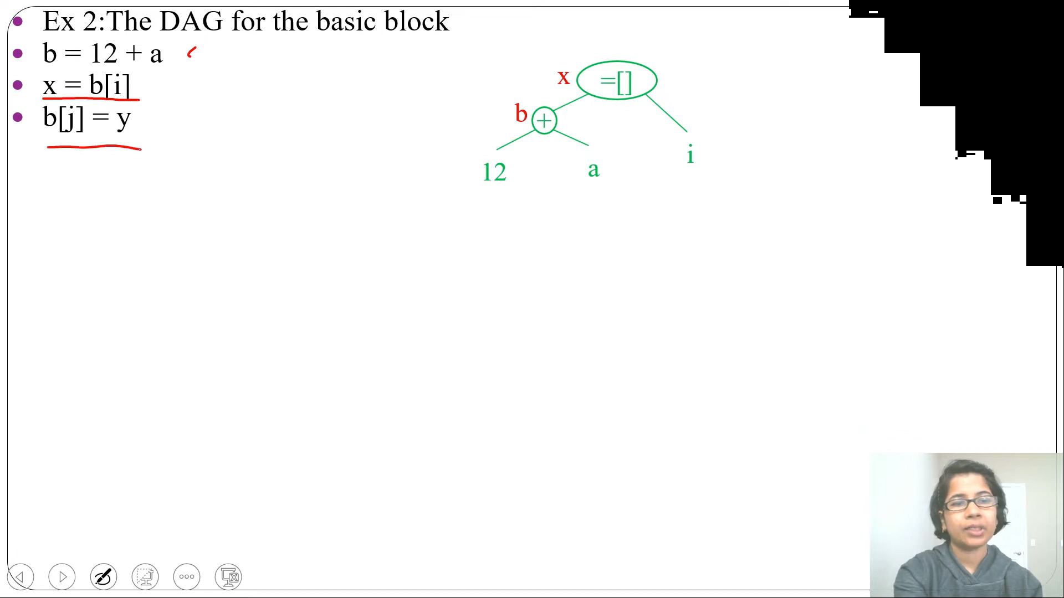

Slide 48
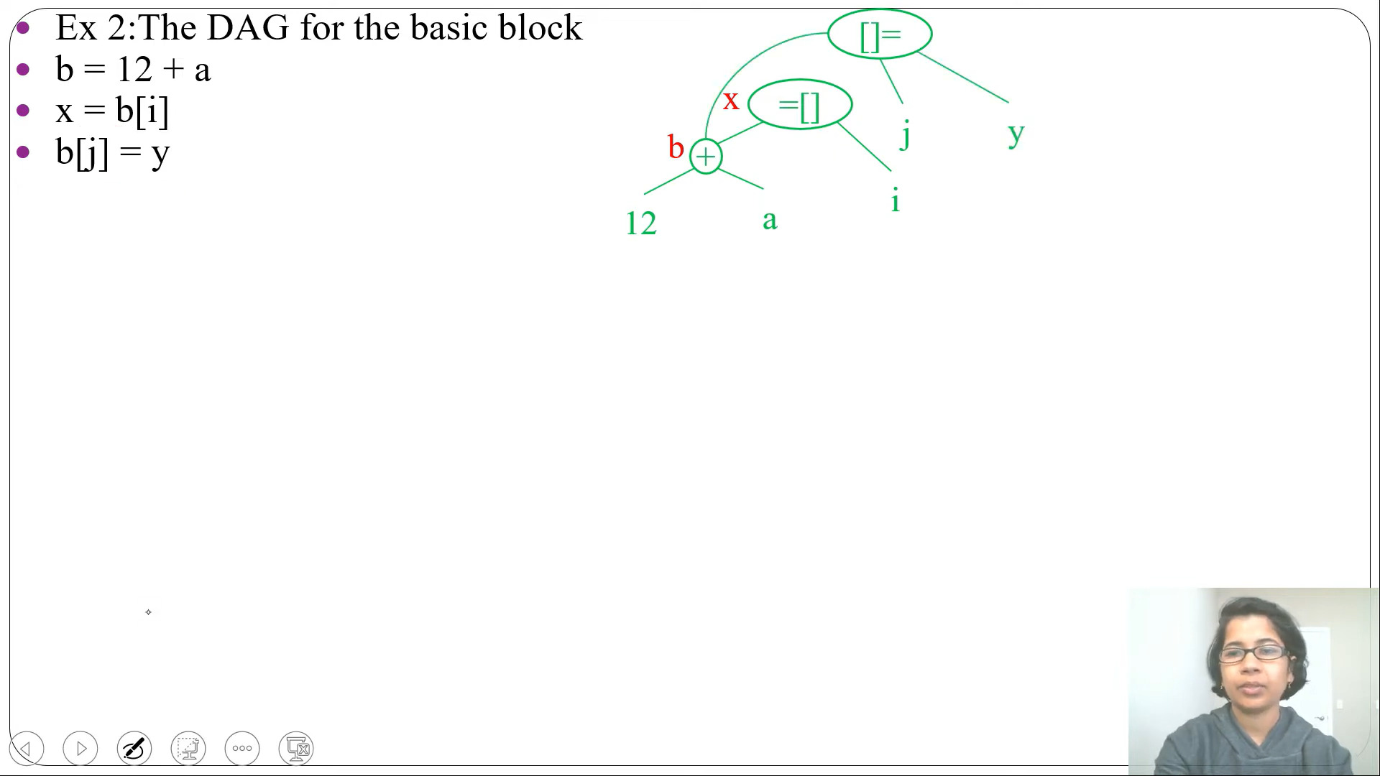

Slide 49
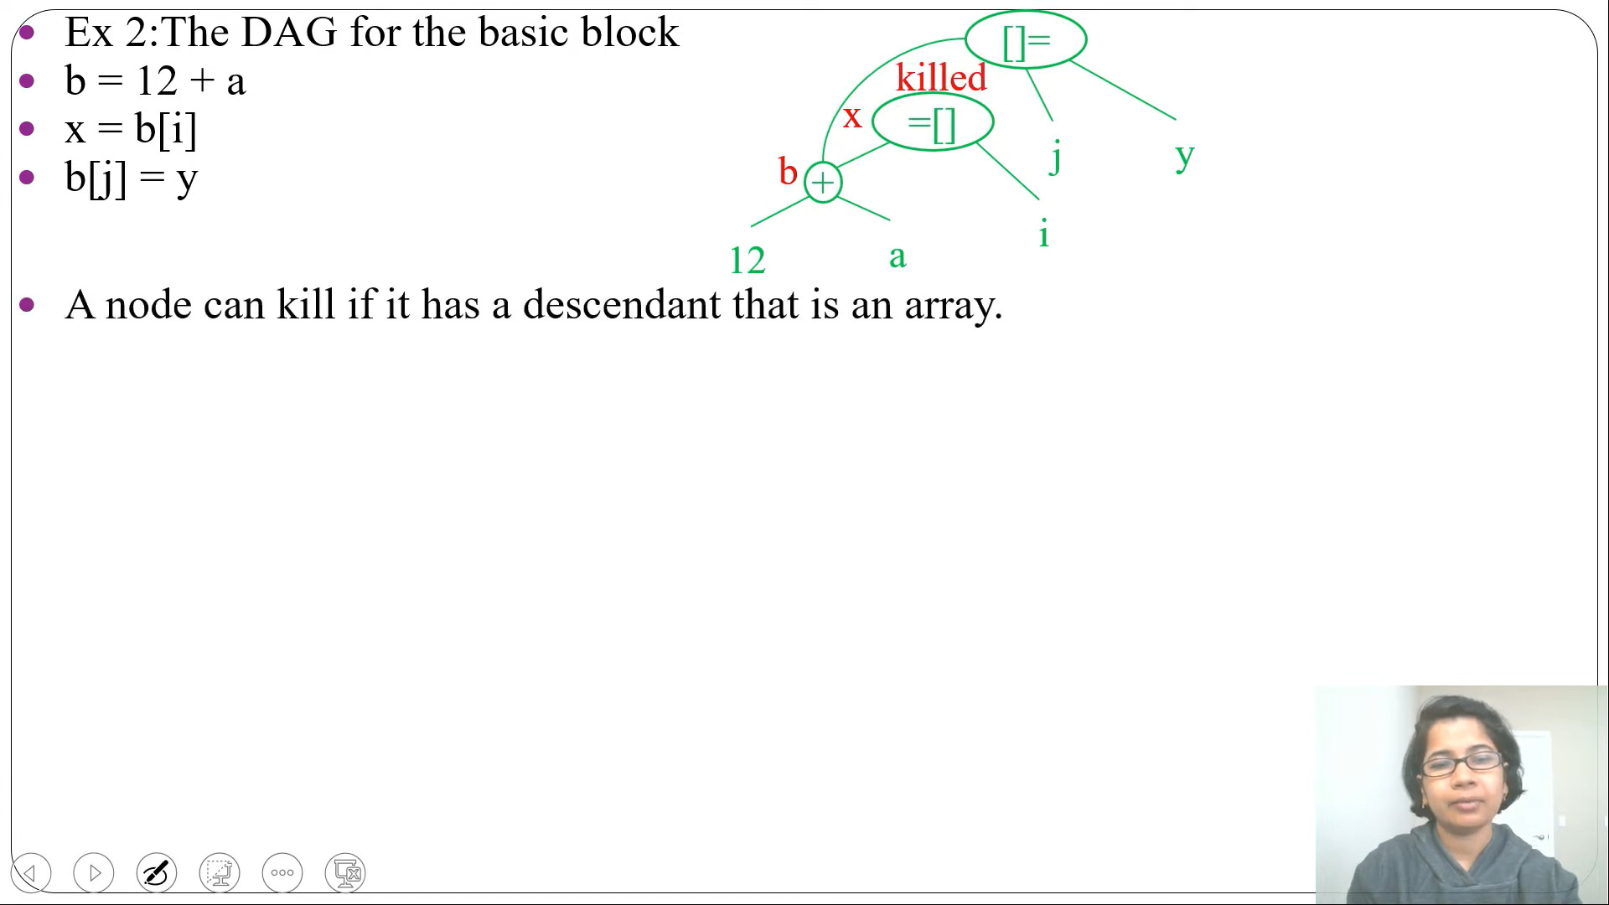

Slide 50
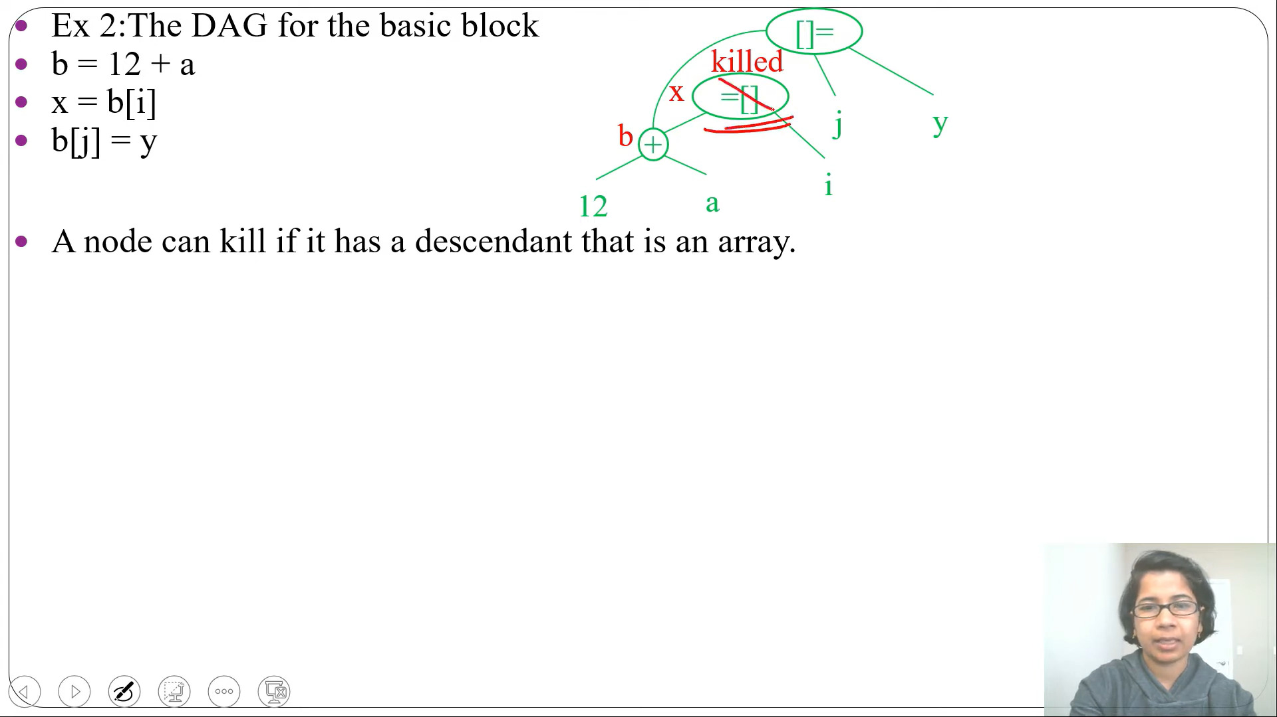

Slide 51
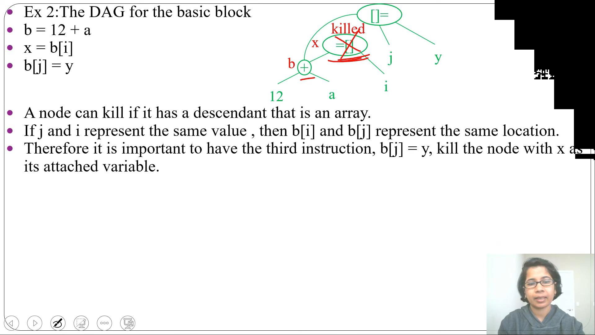

Slide 52
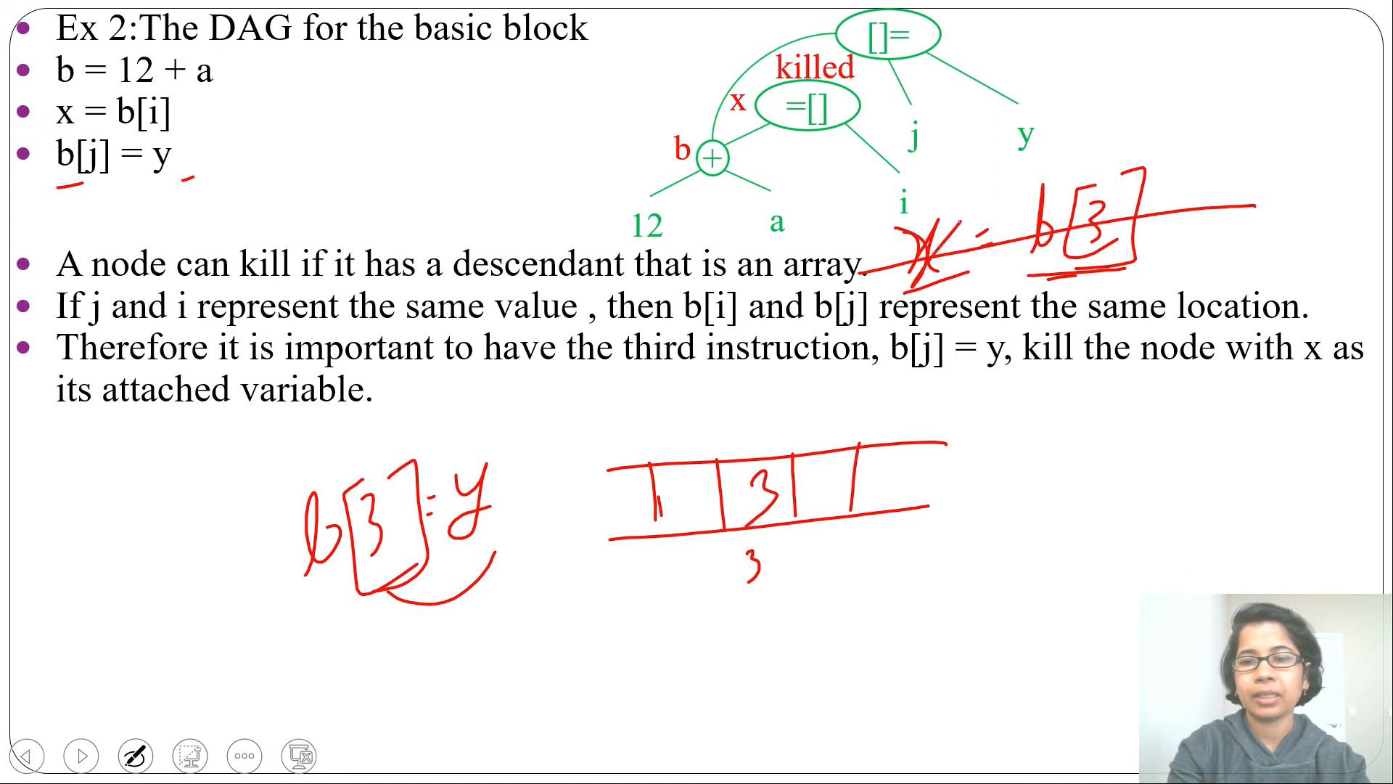

Slide 53
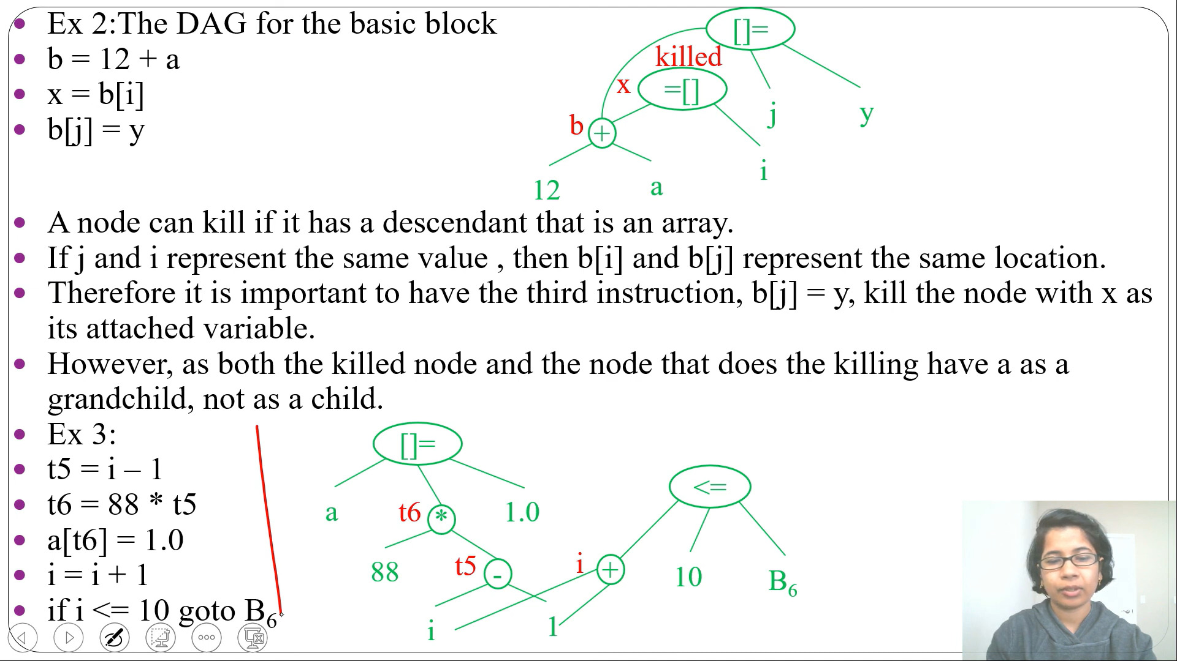

Slide 55
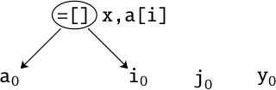
Local Optimization
Array References
x = a[i]
a[j] = y
z = a[i]
Optimizations

Slide 56
Local Optimization
Array References
x = a[i]
a[j] = y
z = a[i]
Optimizations

Slide 57
Array References
Local Optimization
x = a[i]
a[j] = y
z = a[i]
Unsafe!
=[] x,a[i] []= y
_{a0} )¸ _{tL} ,˛_{i0}
_{j},✏
0
,˛_{y0}
Optimizations

Slide 58
Array References
Local Optimization
x = a[i]
a[j] = y
z = a[i]
Unsafe!
=[] x,a[i] []= y
_{a0} )¸ _{tL} ,˛_{i0}
_{j},✏
0
,˛_{y0}
Optimizations

Slide 59
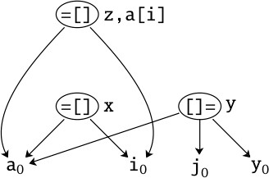
Local Optimization
Array References
x = a[i]
a[j] = y
z = a[i]
Optimizations

Slide 60
Local Optimization
Array References
x = a[i]
a[j] = y
z = a[i]
Optimizations

Slide 61
Remarks
Local Optimization
The entire memory is a single array!
In C: no check of bounds of arrays, so memory can be arbitrarily updated.
Optimizations

Slide 62


Global Optimization
Outline
1 Local Optimization
2 Global Optimization
Optimizations

Slide 63
Global Optimization
Example: quicksort
void quicksort(int a[], int m, int n) {
int i, j, v, x; if (n <= m) return;
/*fragment starts here*/
i = m-1; j = n; v = a[n];
while (1) {
do i = i+1; while (a[i] < v);
do j = j-1; while (a[j] > v);
if (i >= j) break;
x = a[i]; a[i] = a[j]; a[j] = x;
}
x = a[i]; a[i] = a[n]; a[n] = x;
/*fragment end here*/
quicksort(a,m,j); quicksort(a,i+1,n); }
Optimizations

Slide 64
Three-address code for fragments of qsort
Global Optimization
L (1)
(2)
(3)
(4)
L (5)
(6)
(7)
(8)
L (9)
(10)
(11)
(12)
L (13)
L (14)
(15)
i = m-1
j = n
t1 = 4*n v = a[t1] i = i+1
t2 = 4*i t3 = a[t2]
if t3<v goto (5) j = j-1
t4 = 4*j t5 = a[t4]
if t5>v goto (9)
if i>=j goto t6 = 4*i
x = a[t6]
(16)
(17)
(18)
(19)
(20)
(21)
(22)
L (23)
(24)
(25)
(26)
(27)
(28)
(29)
(30)
t7 = 4*i
t8 = 4*j t9 = a[t8]
a[t7] = t9
t10 = 4*j
a[t10] = x goto (5)
t11 = 4*i
x = a[t11]
t12 = 4*i t13 = 4*n t14 = a[t13]
(23)
a[t12] = t14 t15 = 4*n a[t15] = x
Optimizations

Slide 65
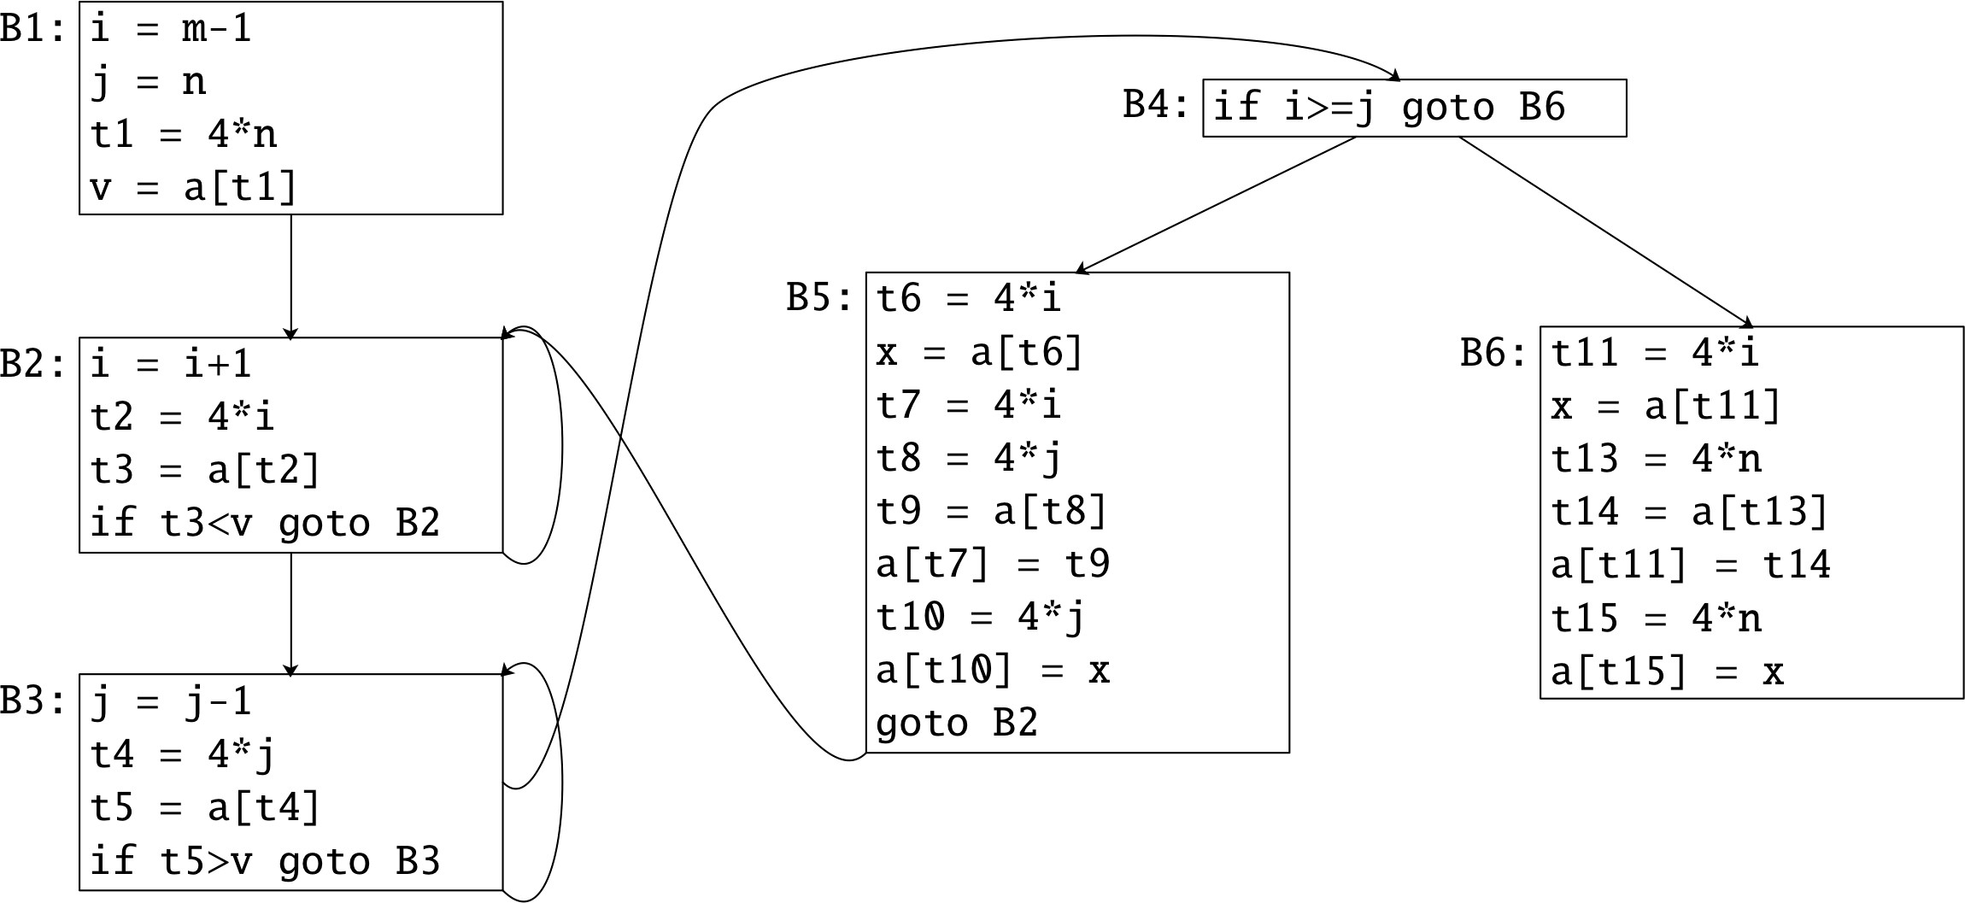
Global Optimization
Basic blocks for quick sort: first try
Optimizations

Slide 66
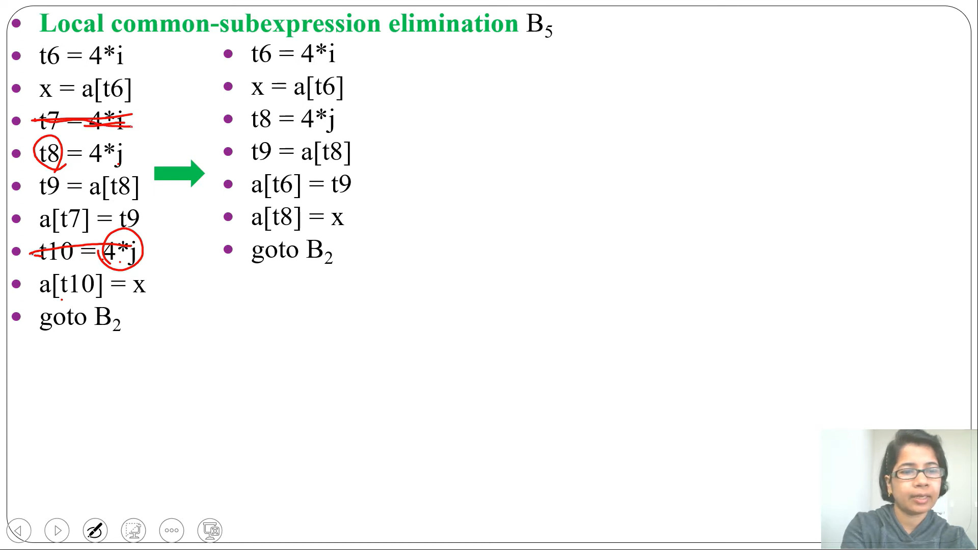

Slide 67
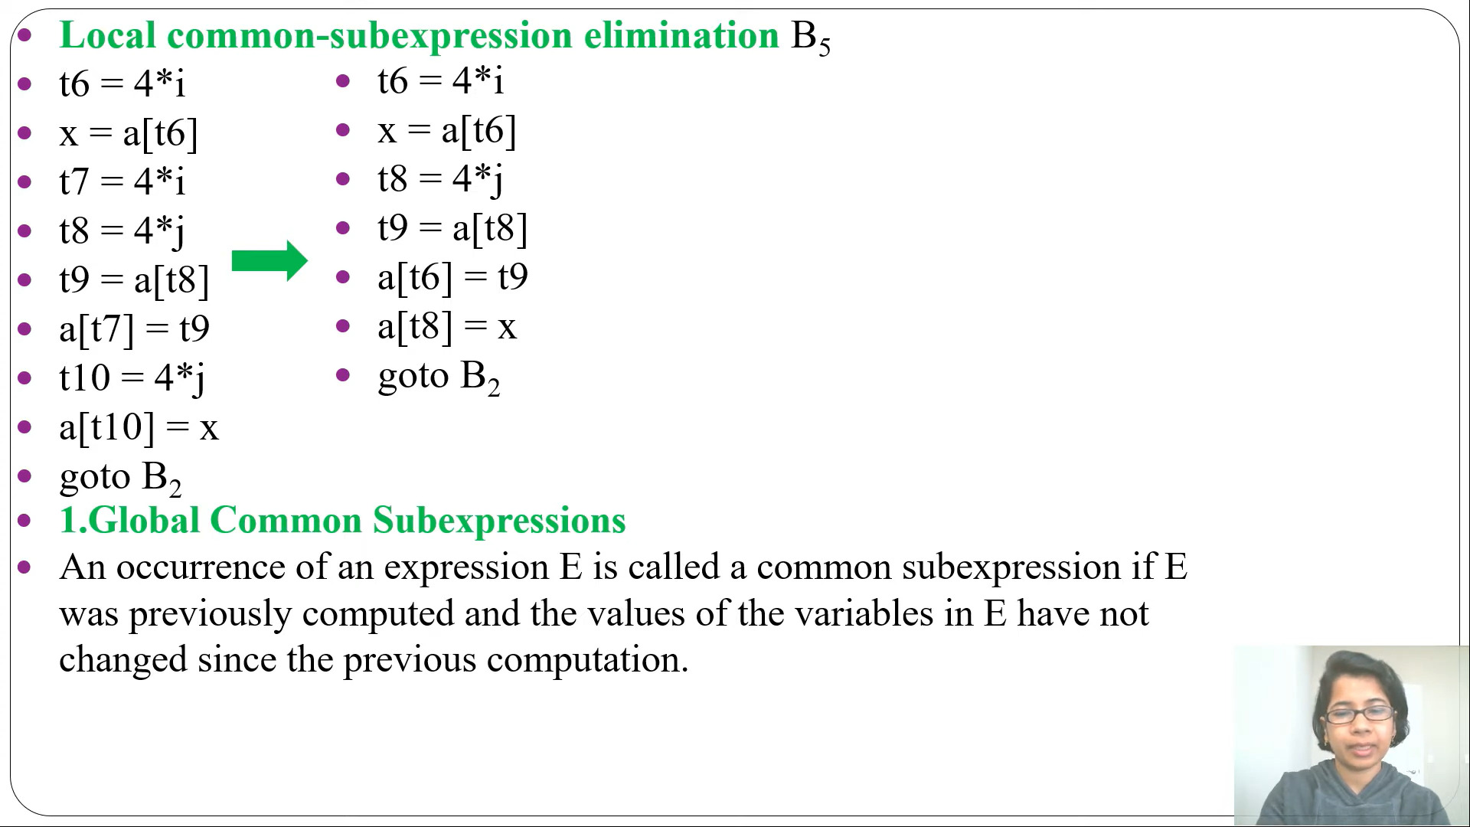

Slide 68
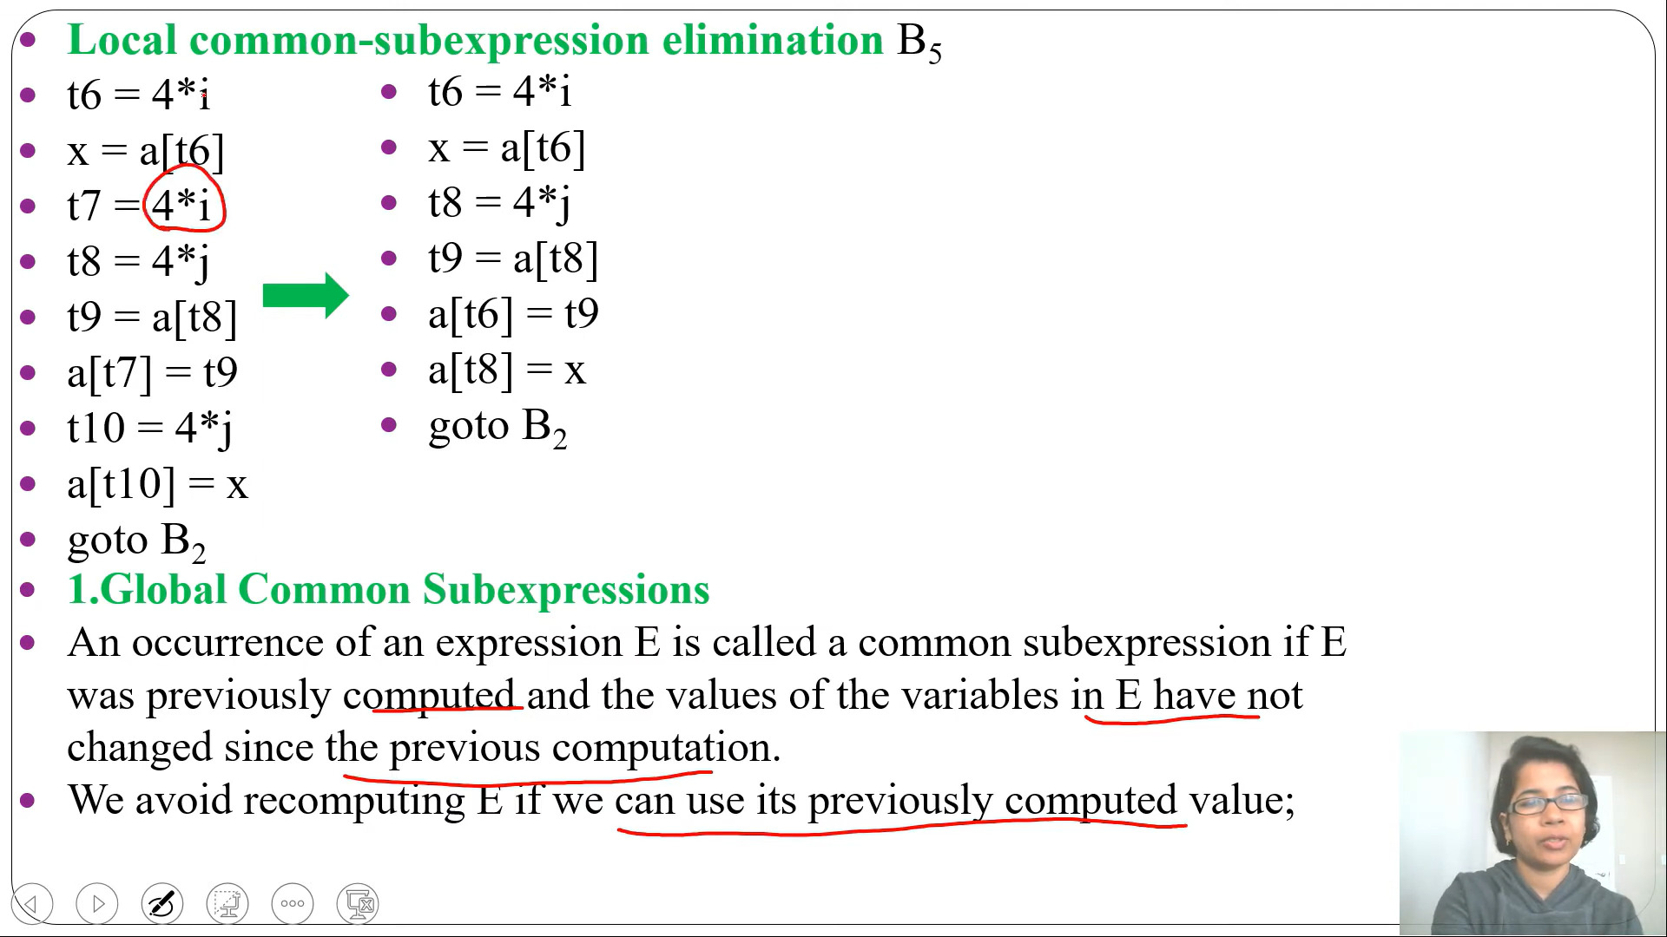

Slide 69
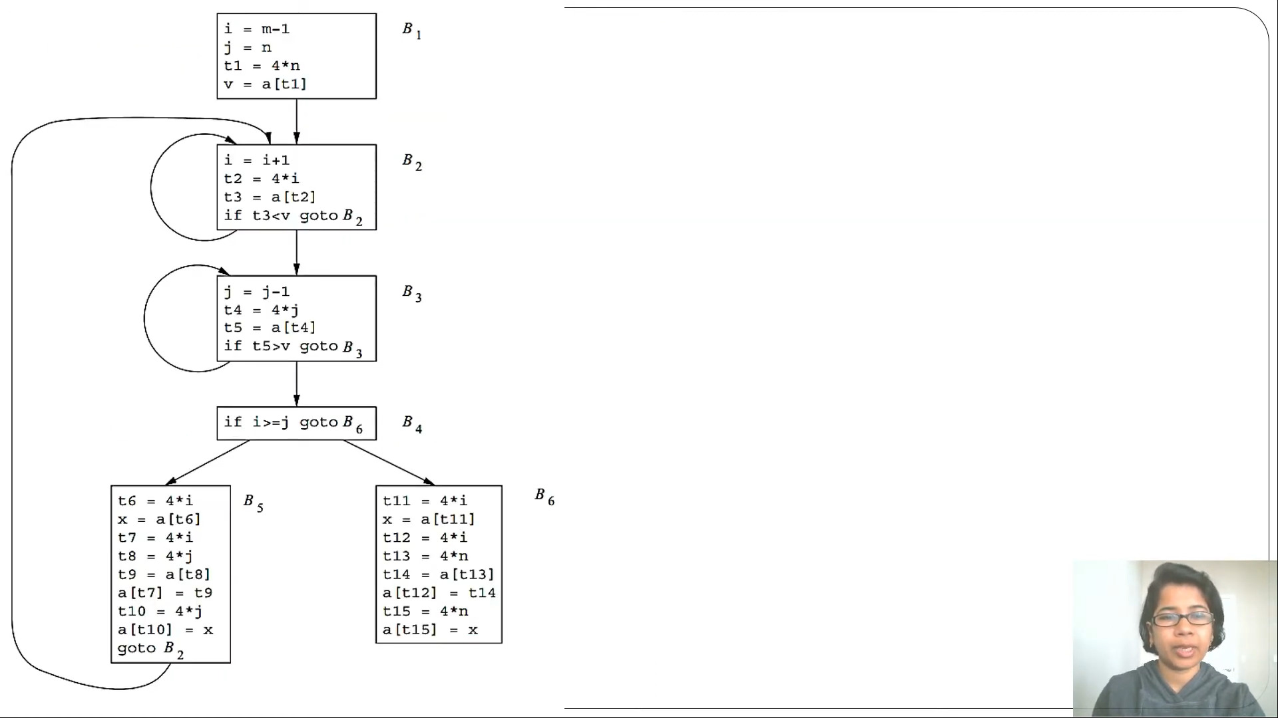

Slide 70
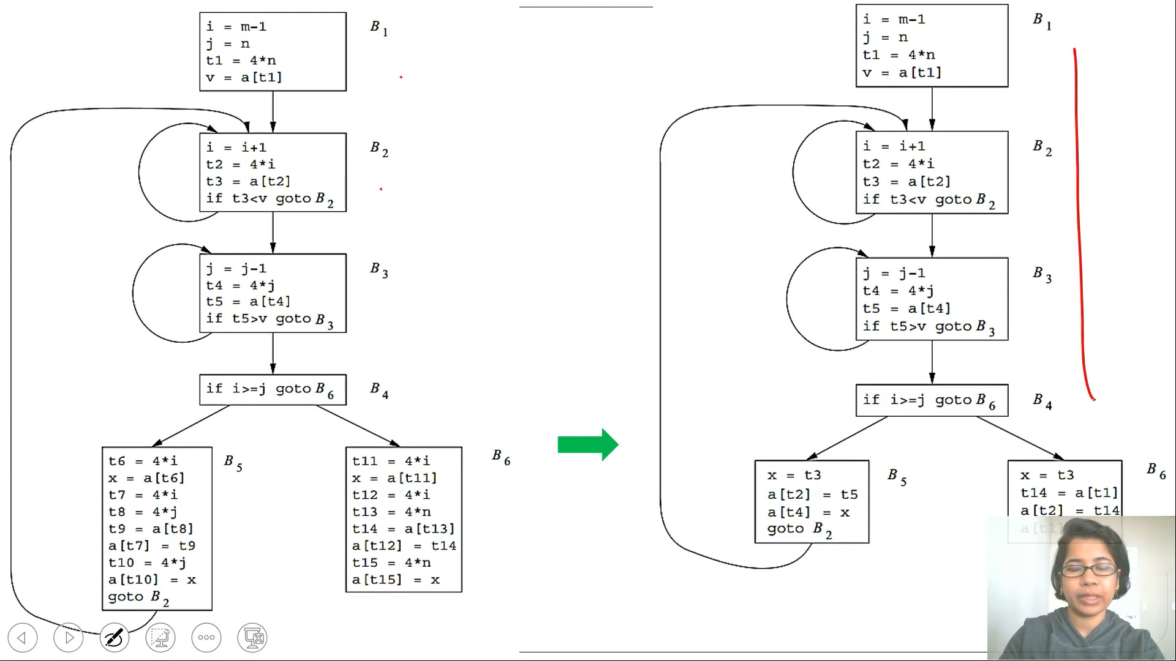

Slide 71
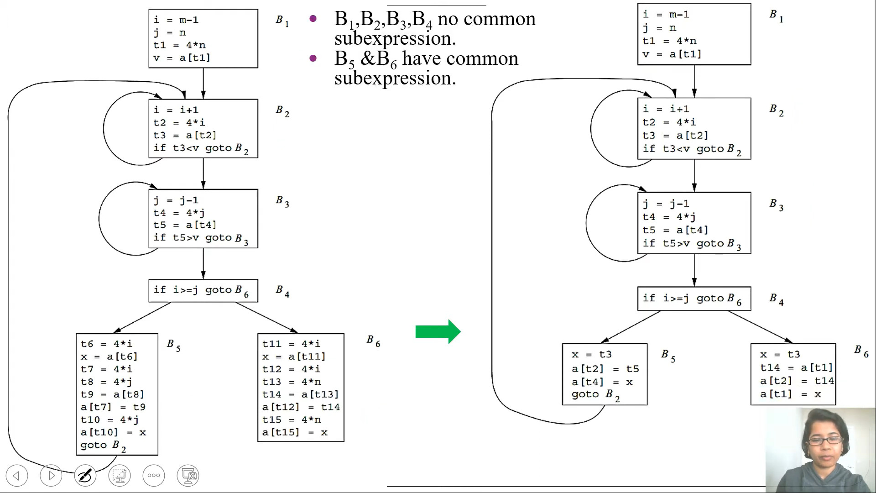

Slide 72
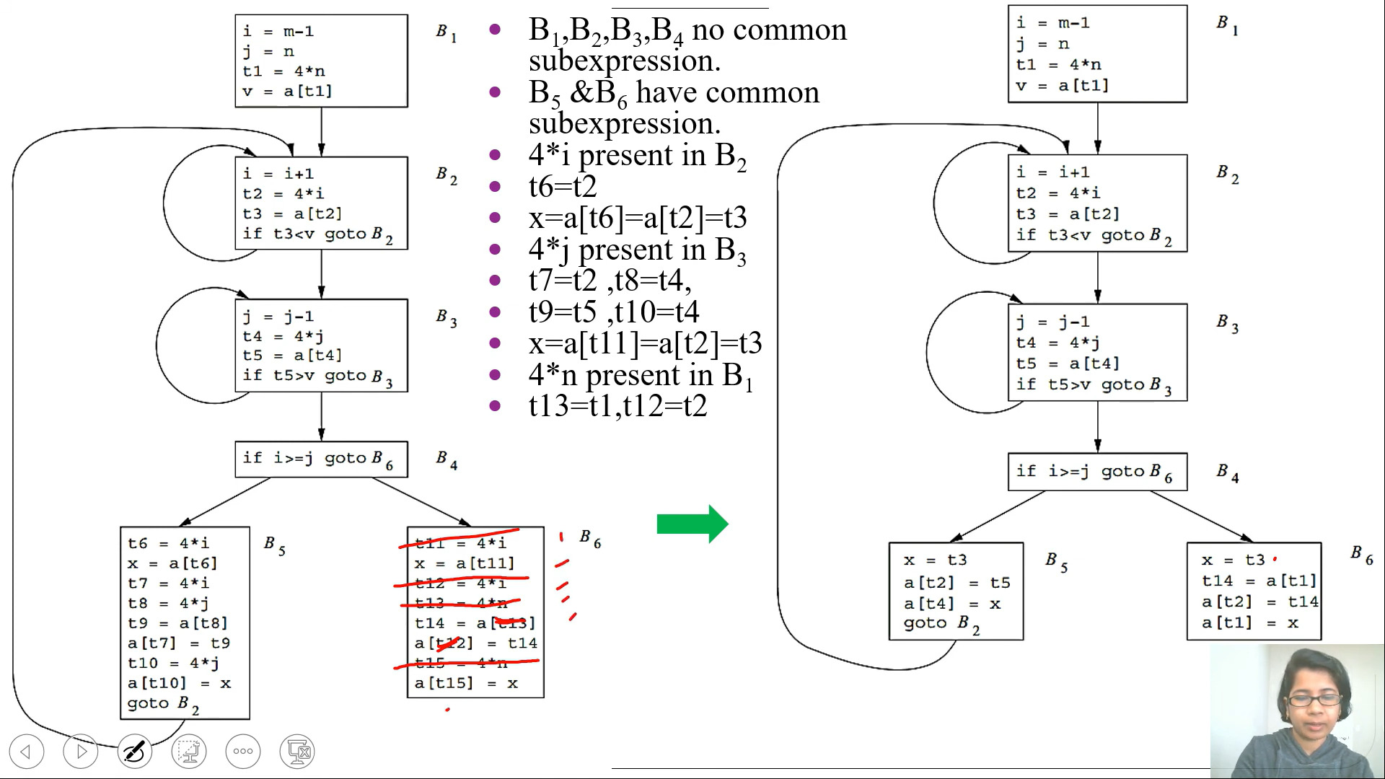

Slide 73
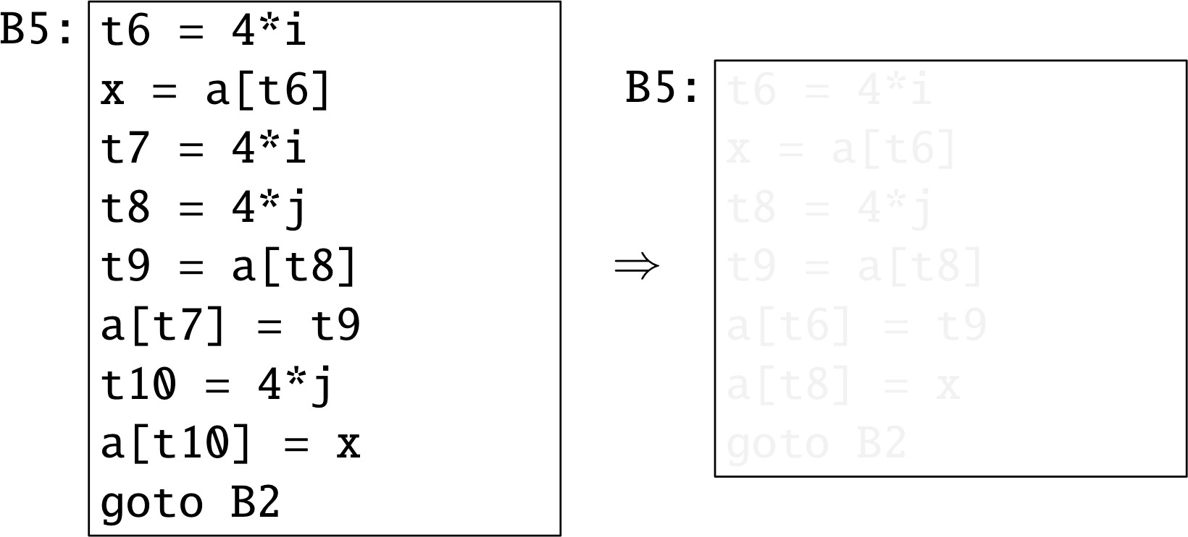
Global Optimization
Local Common Subexpression Elimination
Optimizations

Slide 74
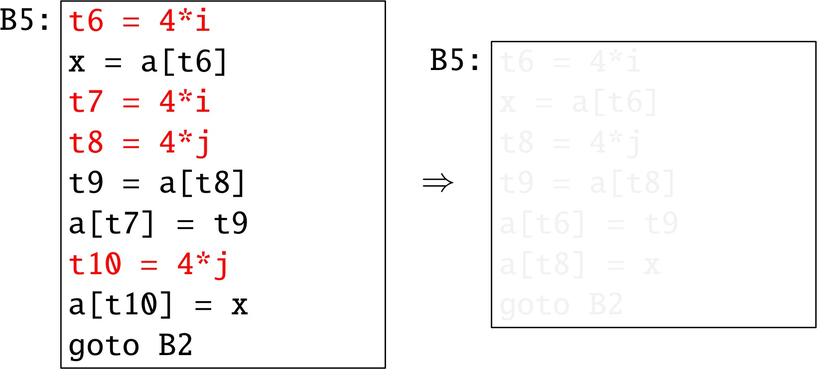
Global Optimization
Local Common Subexpression Elimination
Optimizations

Slide 75
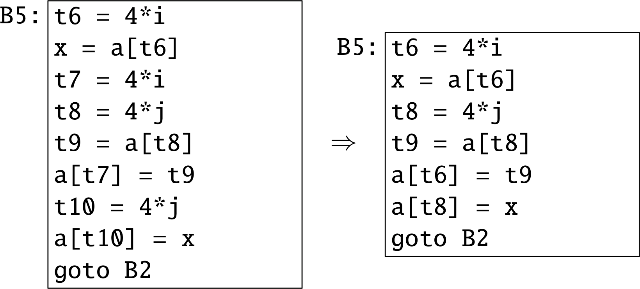
Global Optimization
Local Common Subexpression Elimination
Optimizations

Slide 76
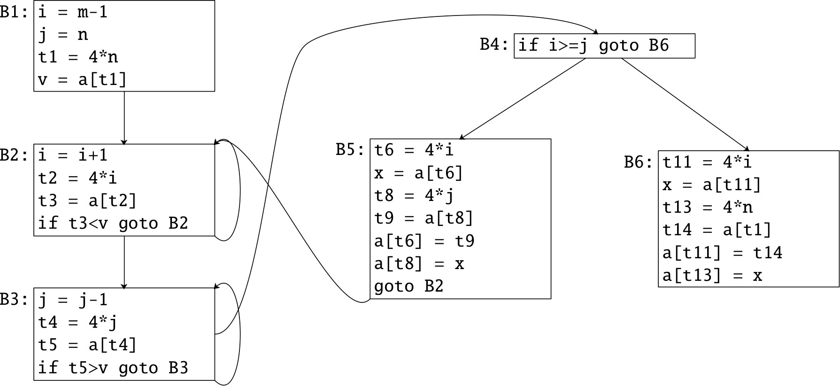
Global Optimization
Global Common Subexpression Elimination
Optimizations

Slide 77
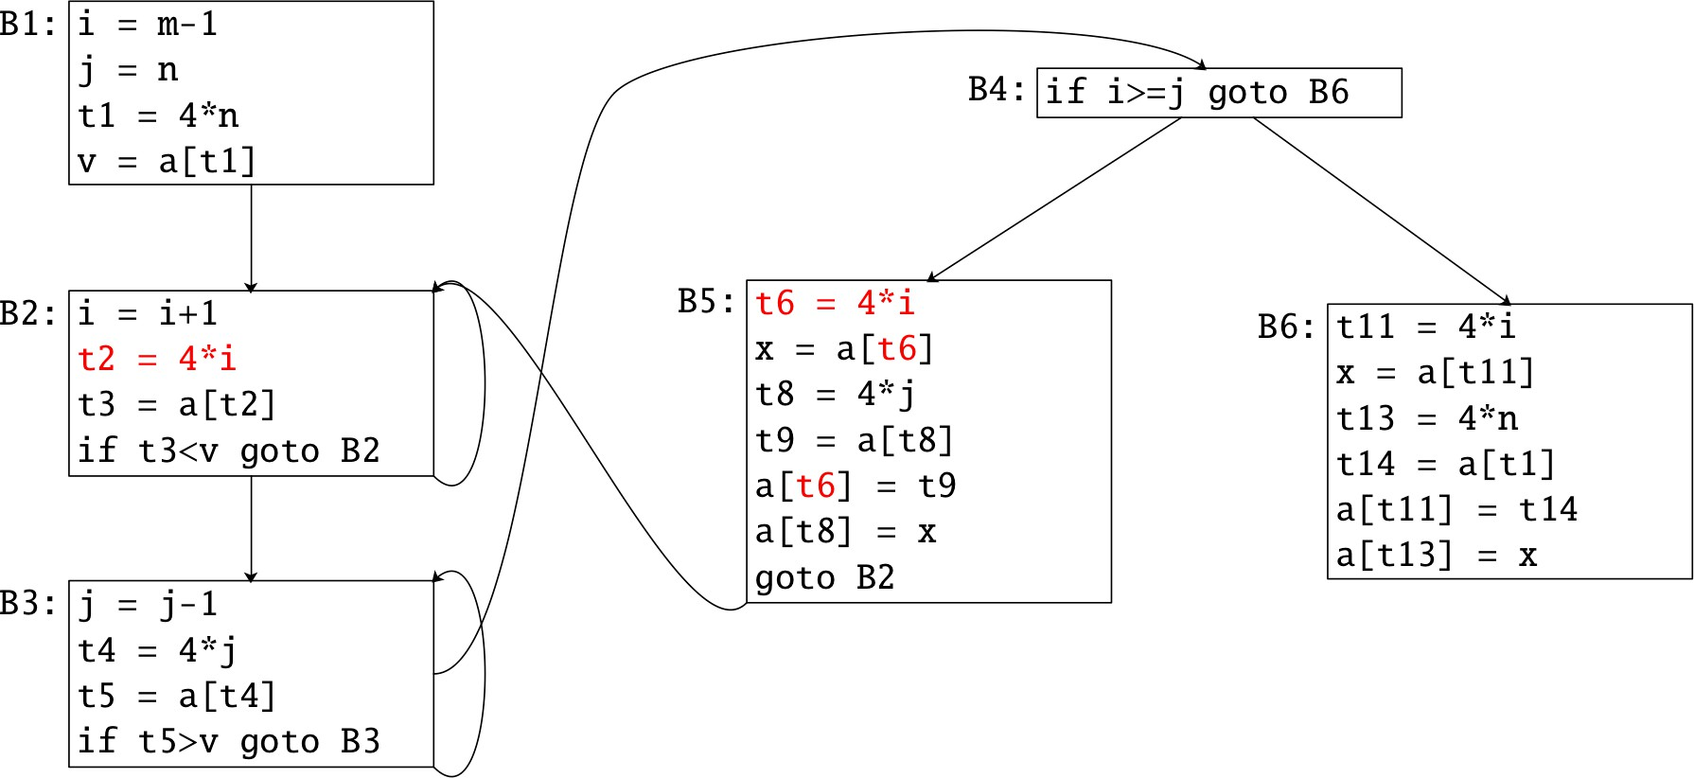
Global Optimization
Global Common Subexpression Elimination
Optimizations

Slide 78
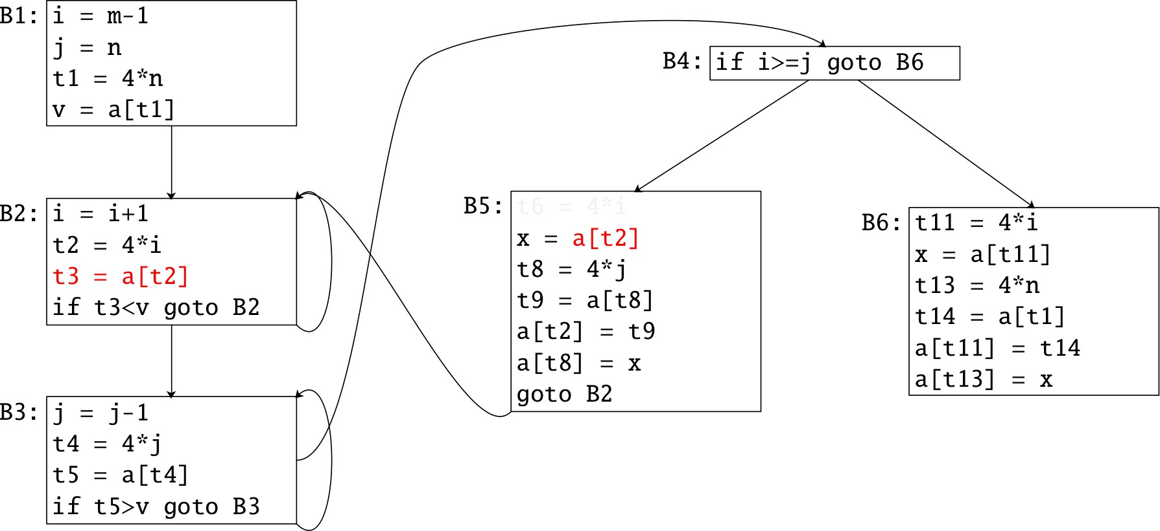
Global Optimization
Global Common Subexpression Elimination
Optimizations

Slide 79
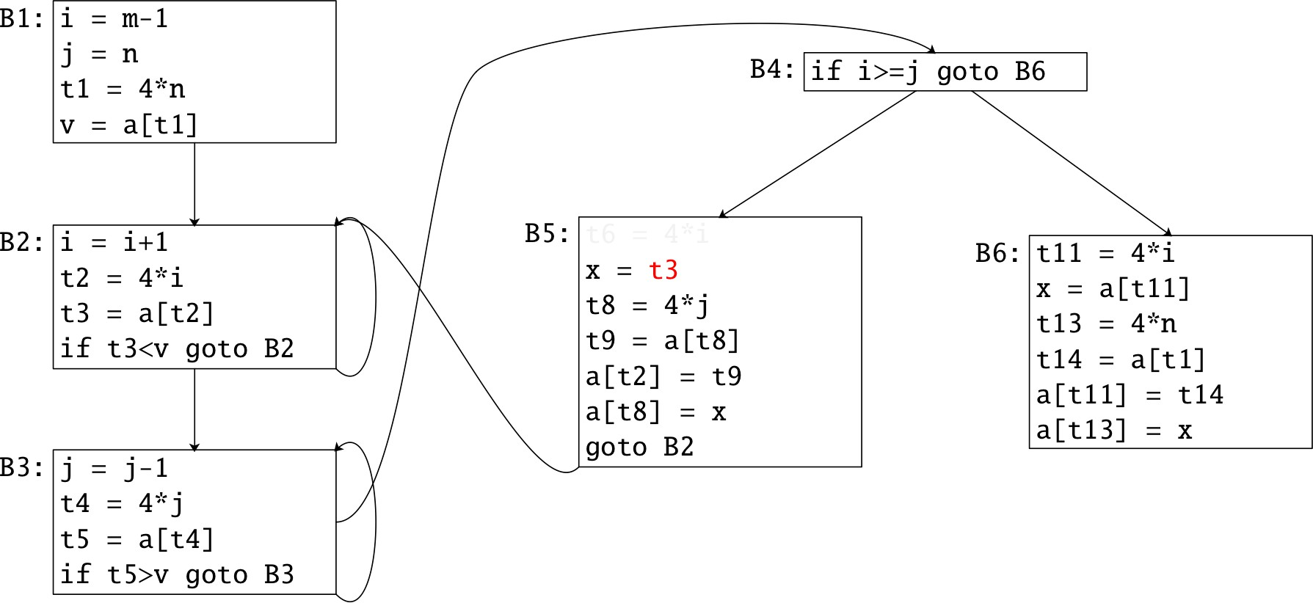
Global Optimization
Global Common Subexpression Elimination
Optimizations

Slide 80
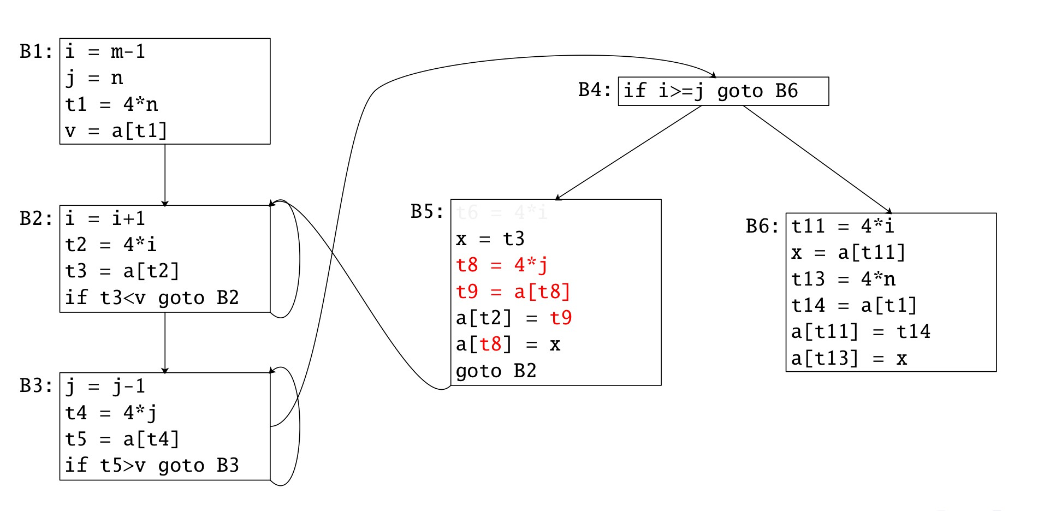
Global Optimization
Global Common Subexpression Elimination
Optimizations

Slide 81

Global Optimization
Global Common Subexpression Elimination
Optimizations

Slide 82

Global Optimization
Global Common Subexpression Elimination
Optimizations

Slide 83

Global Optimization
Global Common Subexpression Elimination
Optimizations

Slide 84

Global Optimization
Global Common Subexpression Elimination
Optimizations

Slide 85

Global Optimization
Global Common Subexpression Elimination
Optimizations

Slide 86


Slide 87


Slide 88


Slide 89


Slide 90


Slide 91


Slide 92


Slide 94

Global Optimization
Copy Propagation
Optimizations

Slide 95
Global Optimization
Copy Propagation
B1:
t = d + e
a = t
B2:
t = d + e
b = t
B3: c = t
Optimizations

Slide 96
Global Optimization
Dead-code Elimination
if (debug) print debug = FALSE
Optimizations

Slide 97

Global Optimization
Code Motion
Optimizations

Slide 98
Summary
Global Optimization
Reduce redundancy but preserve semantics!
Global Common Subexpressions.
Copy Propagation. Dead-code Elimination. Code Motion.
Optimizations

